Slide 1
Measuring privacy leakage in neural networks
Florian Tramèr

Slide 2


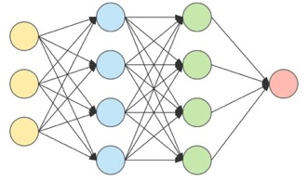



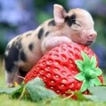
Neural networks learn from a (private) training set.
“cat”
minimize loss

Slide 3
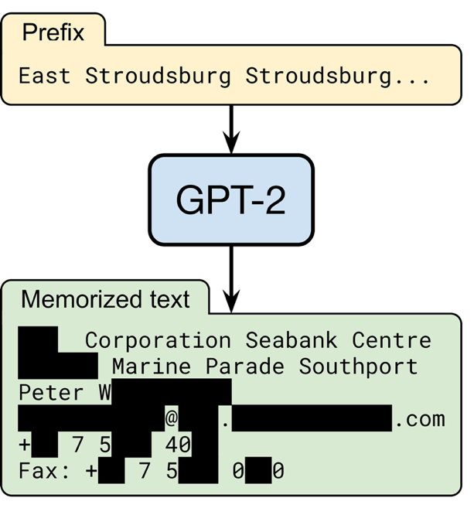
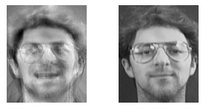
The trained model might leak the training set.
from the Bible (1 Kings 7:2)

Slide 4

This talk: Membership inference attacks
Was
in the training set?

Slide 5
Why should we care about membership inference?
  A real attack (e.g., models trained on medical data)
  An attack component (e.g., for data extraction)
  A simple, formal upper-bound on data leakage
≈
Data privacy
Membership inference attack
Secure encryption
Chosen plaintext attack

Slide 6
Outline.
Most membership attacks (and their evaluations) are flawed
A new principled attack that works on outliers
A new stronger attack that works for any input
Defenses and how to audit them

Slide 7
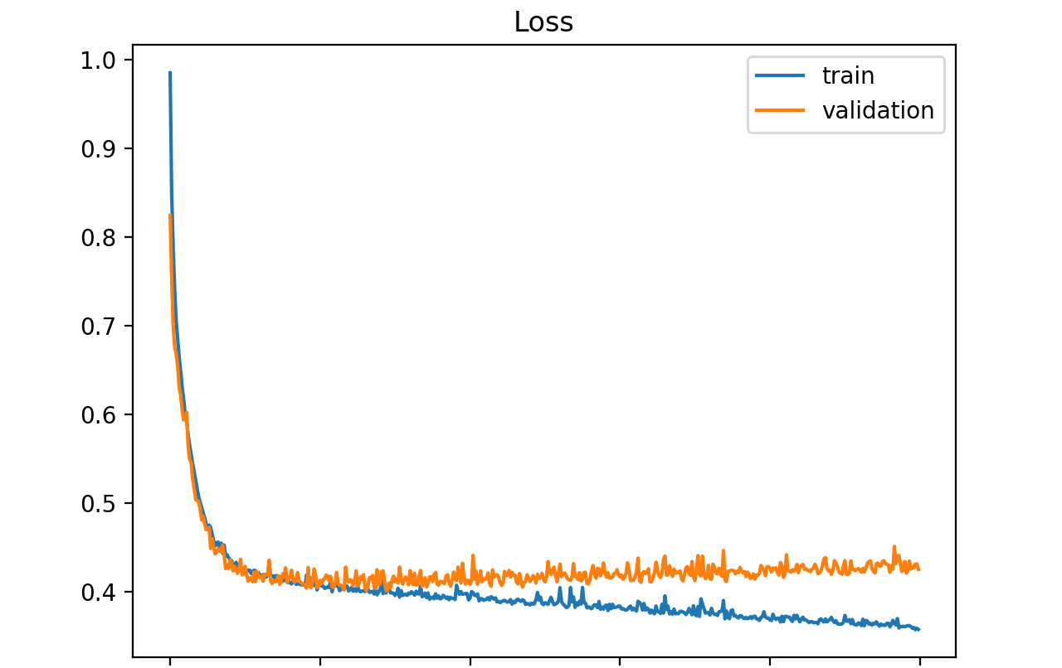
Models are trained to minimize loss.
minimize loss
Loss is (slightly) lower for training examples!

Slide 8
A simple MI attack: “uniform” loss thresholding
[Yeom et al.’18]

Slide 9
A simple MI attack: “uniform” loss thresholding
[Yeom et al.’18]
guess “member”
decision threshold

Slide 10
A simple MI attack: “uniform” loss thresholding
[Yeom et al.’18]
guess “member”
decision threshold

Slide 11
A simple MI attack: “uniform” loss thresholding
[Yeom et al.’18]
guess “member”
decision threshold

Slide 12
A model’s loss leaks membership on average.
AUC-ROC=0.59

Slide 13
A model’s loss leaks membership on average.
Average-case leakage
is a poor metric for privacy!

Slide 14
“Uniform” loss thresholding doesn’t confidently infer membership of any member of the train set!

Slide 15
Our preferred evaluation methodology: low FPRs

Slide 16
LIRA: A better MI attack!
Carlini et al., “Membership Inference Attacks From First Principles”, IEEE S&P ‘22
>1000x better in the worst case
slightly better on average

Slide 17
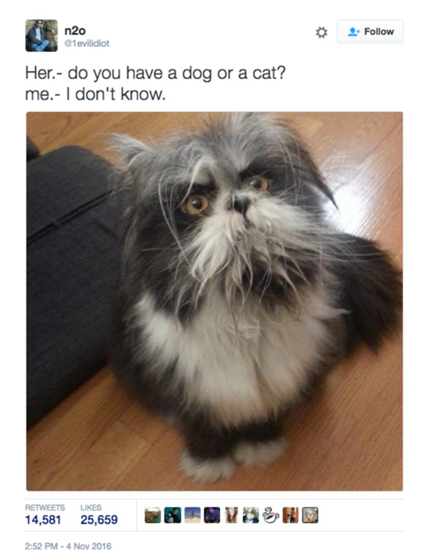
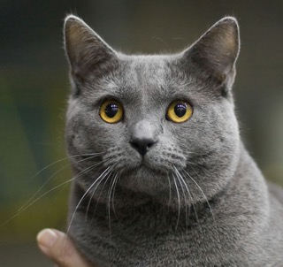
Insight: not all examples are equally “hard”
[Sablayrolles et al.’19, Long et al.’20, Feldman & Zhang’20, Watson et al.’21, Ye et al.’21]
Which is a member?
loss: 10⁻⁴
loss: 0.01

Slide 18


Insight: not all examples are equally “hard”
[Sablayrolles et al.’19, Long et al.’20, Feldman & Zhang’20, Watson et al.’21, Ye et al.’21]
Which is a member?
loss: 10⁻⁴
loss: 0.01

Slide 19

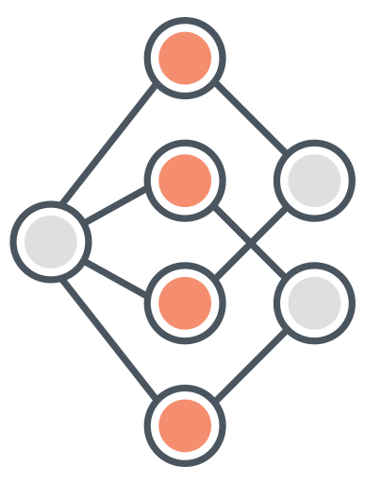


Let’s try a membership inference attack!
$$?$$
$$∈$$
Notes:
2m30
We’ll try to do membership inference for this very canonical cat image here.
Given a trained model, we’d like to check whether this image was in the training set or not.
For now, there will be no poisoning.

Slide 20
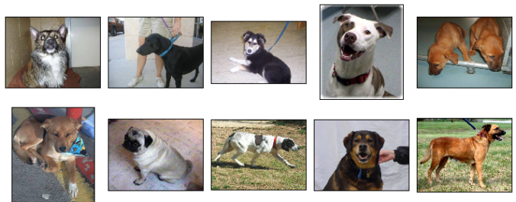
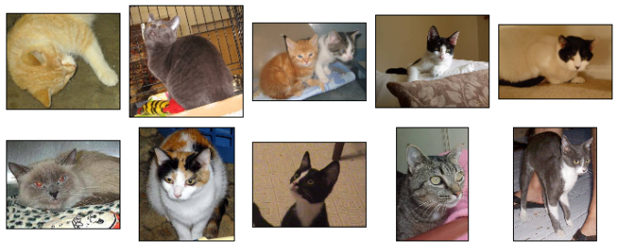


Training set
loss
Notes:
We’ll do this in a black-box way by just looking at the model’s output confidence.
If the image is in the training set, the model is very confident in its prediction, essentially 100%.

Slide 21
Training set
loss
Notes:
But even if the image is not in the training set, the model’s output barely changes.
Because this is such a canonical picture of a cat, the model doesn’t have to be trained on this specific image to get very high confidence.

Slide 22
Training set
loss
Notes:
We’ll do this in a black-box way by just looking at the model’s output confidence.
If the image is in the training set, the model is very confident in its prediction, essentially 100%.

Slide 23
Training set
loss
Notes:
But even if the image is not in the training set, the model’s output barely changes.
Because this is such a canonical picture of a cat, the model doesn’t have to be trained on this specific image to get very high confidence.

Slide 24
Membership inference as a likelihood test.
models trained on image
models not trained on image
loss

Slide 25
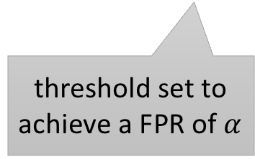
Membership inference as a likelihood test.
models trained on image
models not trained on image
loss
threshold set to achieve a FPR of $α$

Slide 26
Let’s try again!
$$?$$
$$∈$$
Notes:
let’s try again. But this time we’ll try an image that’s a bit more unusual. This is a cat that looks very much like a dog.

Slide 27
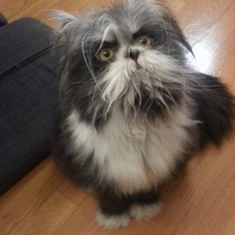
Training set
loss
Notes:
So now when this image is not in the training set, the model is really not sure what it’s looking at. It could really be either way.

Slide 28

Training set
loss
Notes:
But if this cat is in the training set with its correct label, the model will likely overfit a little bit and memorize the correct cat label

Slide 29
Training set
loss
Notes:
So now when this image is not in the training set, the model is really not sure what it’s looking at. It could really be either way.

Slide 30
Training set
loss
Notes:
But if this cat is in the training set with its correct label, the model will likely overfit a little bit and memorize the correct cat label

Slide 31
Some examples are easier to distinguish.
models trained on image
models not trained on image
loss

Slide 32
Membership inference with per-example likelihood
>1000x better in the worst case
(thanks to Gaussian fitting + numeric stability + multiple queries + ...)

Slide 33
Membership inference works well on “outliers”.

Slide 34
Next: a new attack that works on any example!

Slide 35
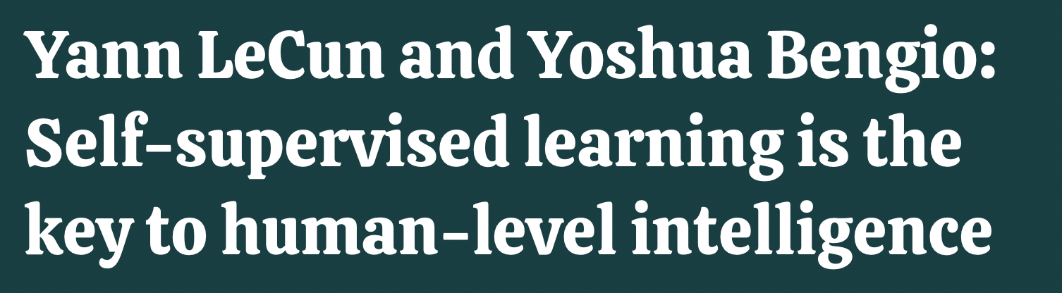

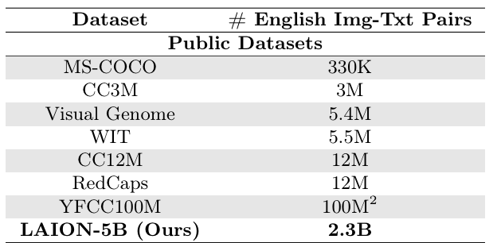
Idea: use data poisoning
35
Notes:
5m
So this is where poisoning comes in.
Let's turn back to our cute cat from before which we couldn’t attack.
Except that now, we’ll use poisoning to essentially turn this image into an outlier, so that membership inference can succeed.

Slide 36
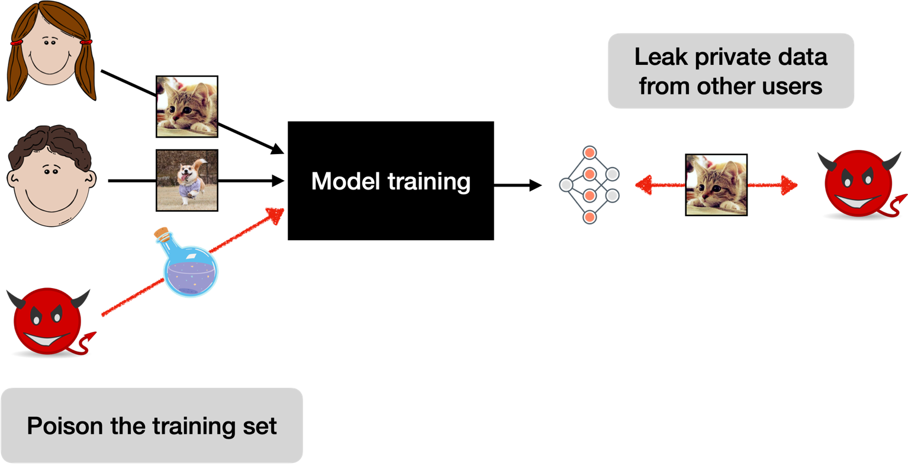

A new threat model: privacy poisoning
Tramèr et al. “Truth Serum: Poisoning Machine Learning Models to Reveal Their Secrets”, CCS ’22
36
Notes:
For this, we introduce a new threat model we call privacy poisoning.
Here, the adversary first poisons a part of a model’s training set, and then tries to interact with the trained model to leak private data that was contributed by other parties.

Slide 37


Data poisoning can create “fake” outliers.
dog
dog
cat
dog
dog
37
Notes:
The simplest way to do this is just to poison the model by adding a bunch of mislabeled copies of our cat.
So now the model is going to think that this is really a dog, and the correctly labeled image will be treated as an outlier.

Slide 38
Training set
loss
38
Notes:
5m30
Let’s see how our membership inference attack works now in the presence of poisoning.
When the target image is not in the training set, we still have all the mislabeled poison copies and so the model will misclassify this image as a dog with very high confidence.

Slide 39
Training set
loss
39
Notes:
If the correctly labeled target image is in the training set, then it will counterbalance the poisons a bit. The model will likely still be wrong but not as confident as before.

Slide 40
Training set
loss
40
Notes:
and so now the attack succeeds, because we can easily distinguish when the target image is a member or not

Slide 41
Training set
loss
41
Notes:
by checking whether the poisoning attack was counteracted on or not.

Slide 42
–
–
with poisoning
without poisoning
with targeted poisoning of <0.1% of the CIFAR-10 training set
42
Notes:
6m30
We find that this simple poisoning strategy, which we call a “label flipping” attack works extremely well at boosting the success of membership inference.
Here we evaluate the attack on the CIFAR-10 dataset.
The strongest attack here is one that lands in the top-left corner: this is an attack that maximizes the true-positive rate or recall, which is the fraction of members that the attack successfully identifies, while keeping that attack’s false-positive rate low. This is the fraction of incorrect membership inferences.
Note that the false-positive rate is on a log-scale here, because for privacy we typically care about attacks that make very confident inferences.
If we look at the baseline attack without poisoning, we see that if we want a very confident attack, which makes very few mistakes, then we only get a low true-positive rate.
That is because the only points where the attack succeeds extremely confidently are outliers, as we saw.
But with a small amount of targeted poisoning, on the order of 0.1% of the training data, we can turn most points into outliers and make the attack succeed.
If we look at these numbers differently, we can also say that if we want an attack that correctly infers membership for half of the training data, then by poisoning the dataset we can reduce the attack’s error rate by nearly a factor of 500.

Slide 43
How to defend against membership leakage?
defense
loss
loss

Slide 44
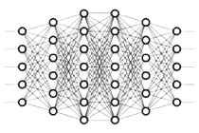
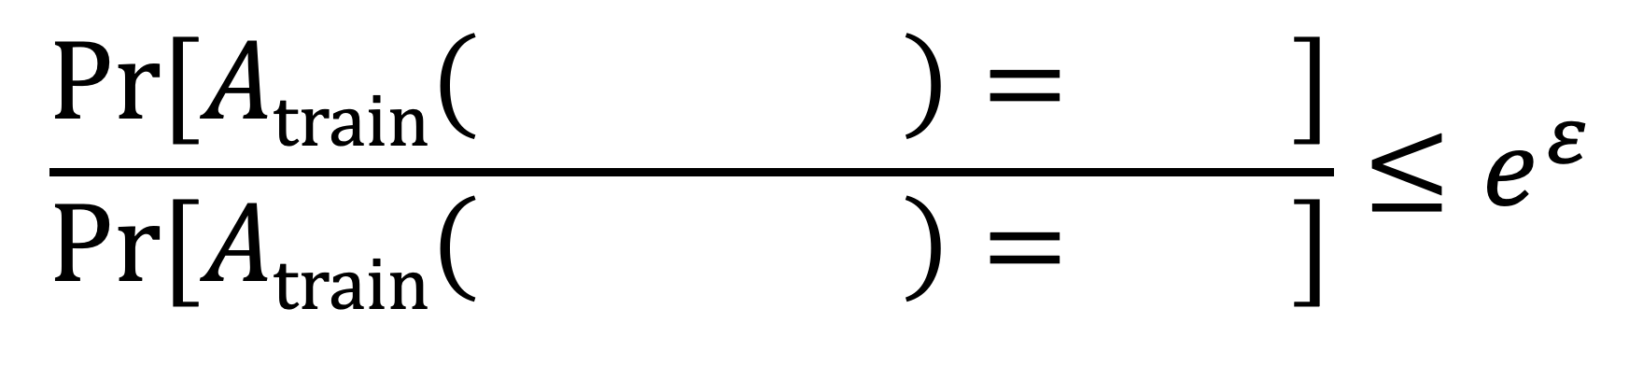
Differential privacy prevents all our attacks.
DP guarantee holds for any pair of datasets that differ in any single element
$$\frac{\text{Pr}[Atrain\left( \right)= ]}{\text{Pr}[Atrain\left( \right)= ]}≤e^{ε}$$

Slide 45
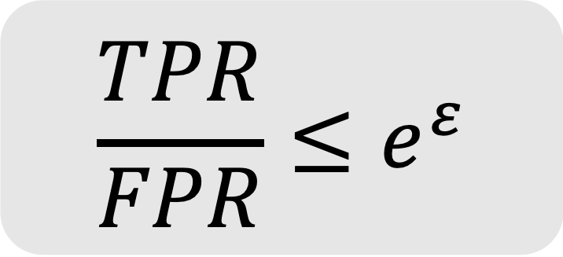
DP bounds the success of any MI attack.
[Kairouz et al. ‘15]
$$\frac{TPR}{FPR}≤e^{ε}$$

Slide 46
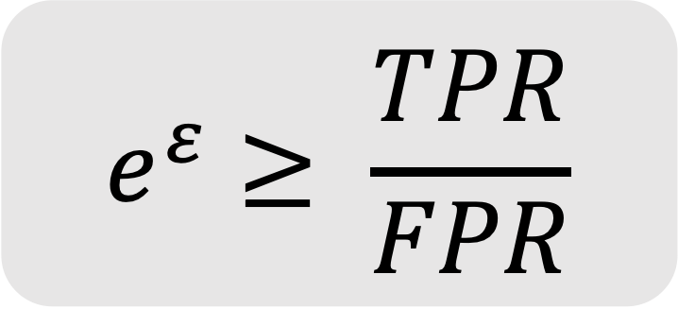
Corollary: MI attacks can be used to audit privacy.
[Jagielsky et al. ‘20, Nasr et al. ’21]
$$e^{ε}≥ \frac{TPR}{FPR}$$

Slide 47
Example: DP with 98% accuracy on MNIST
Proof-of-concept
[Shokri & Shmatikov]
Better architectures
[Papernot et al.]
Tighter analysis
[Abadi et al.]
Better features
[T & Boneh]

Slide 48
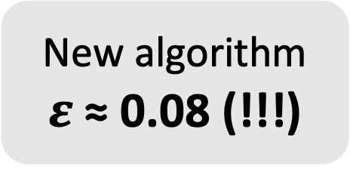
Example: DP with 98% accuracy on MNIST
New algorithm
$ε$ ≈ 0.08 (!!!)

Slide 49
Example: DP with 98% accuracy on MNIST
Is this claim correct?

Slide 50
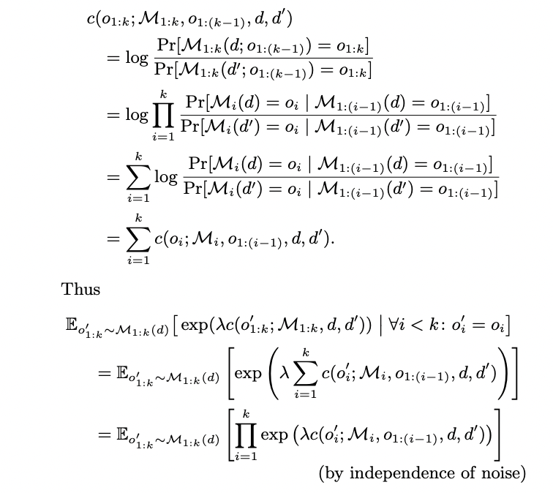
How to verify a DP claim?
Check the proof

Slide 51
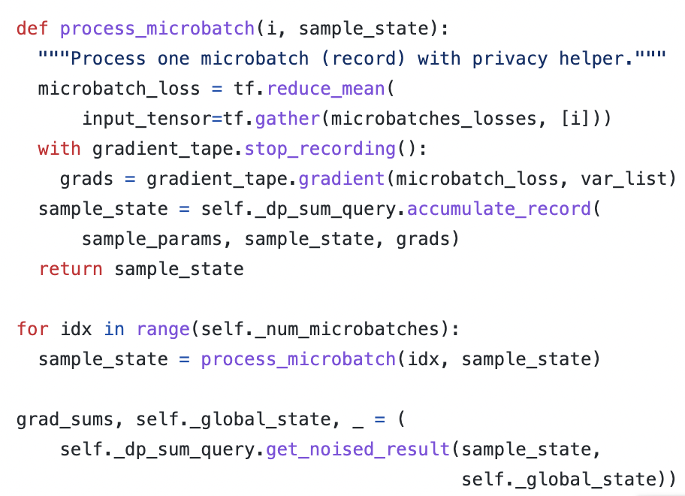
How to verify a DP claim?
Check the proof
Check the code

Slide 52
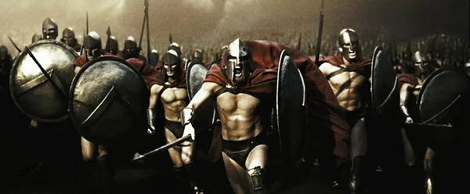
How to verify a DP claim?
Check the proof
Check the code
Launch an attack!

Slide 53


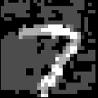

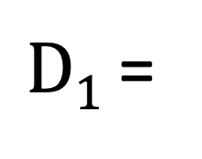
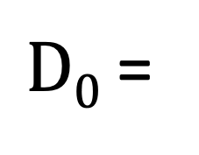
DP bounds should hold for any data point.
$D0$ =
worst-case
out-of-distribution data point
...
$D1$ =
...
Attack goal: guess if is a member of the training set

Slide 54

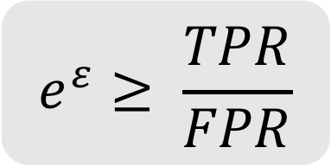
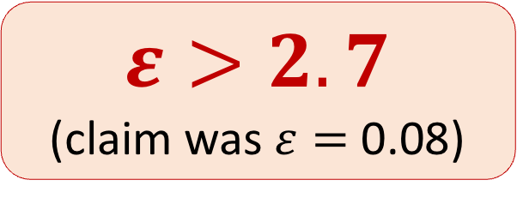
Run the attack 100’000 times...
Tramèr et al. “Debugging Differential Privacy: A Case Study for Privacy Auditing”, 2022
$$Train on D0$$
$$e^{ε}≥ \frac{TPR}{FPR}$$
$$Train on D1$$
$$ε>2.7$$
(claim was$ε=$ 0.08)
Model loss on

Slide 55
Conclusion
Average-case leakage is a poor metric for privacy!
We must reevaluate what we “know” about MI attacks & defenses
Poisoning can turn average-case inputs into worst-case inputs
Worst-case MI attacks are a useful tool for catching DP bugs

