Slide 1
Why you should treat your
ML defense like a theorem
Florian Tramèr
Stanford → Google → Vacation → ETHZ

Slide 2

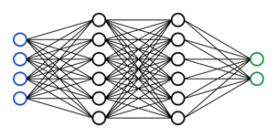
Defense⬄Theorem
My is robust.

Slide 3
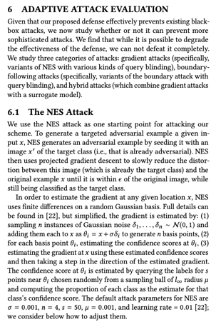
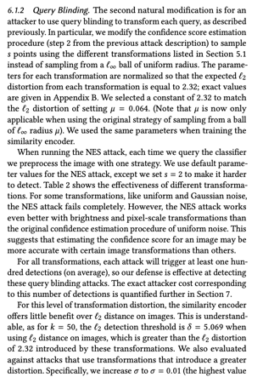
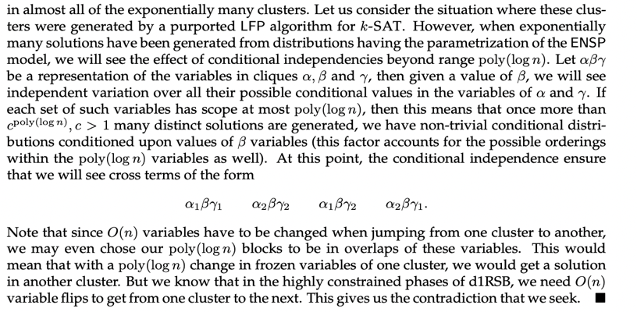
Defense⬄Theorem, Evaluation⬄Proof.
My is robust.

Slide 4
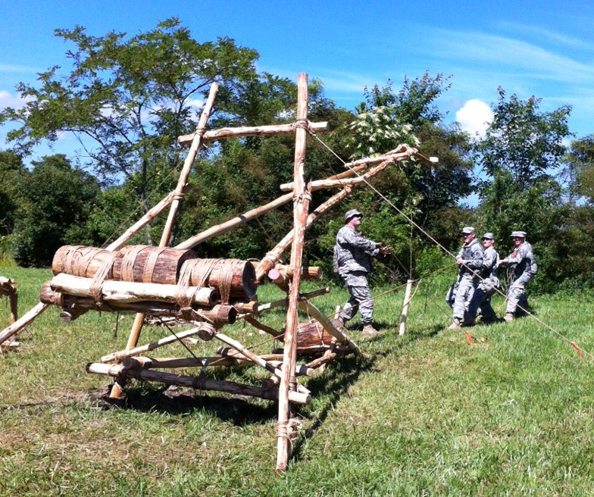
Today: refuting a defense = building an attack.
My is robust.

Slide 5
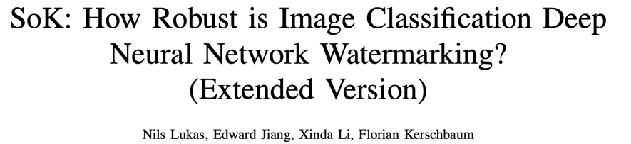
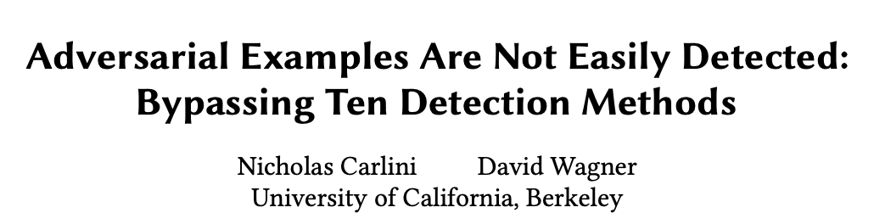
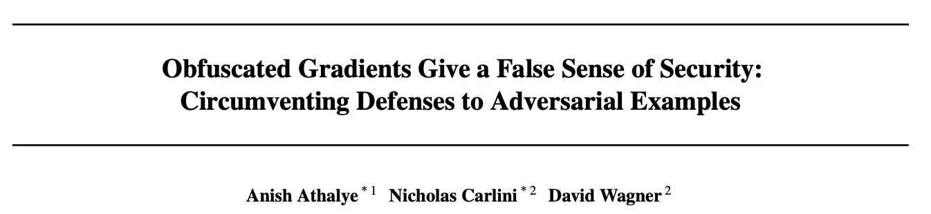
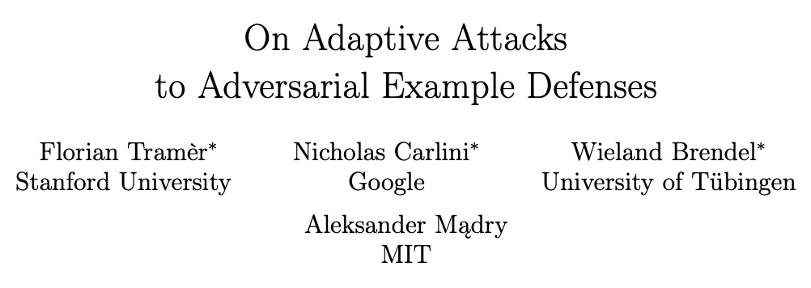
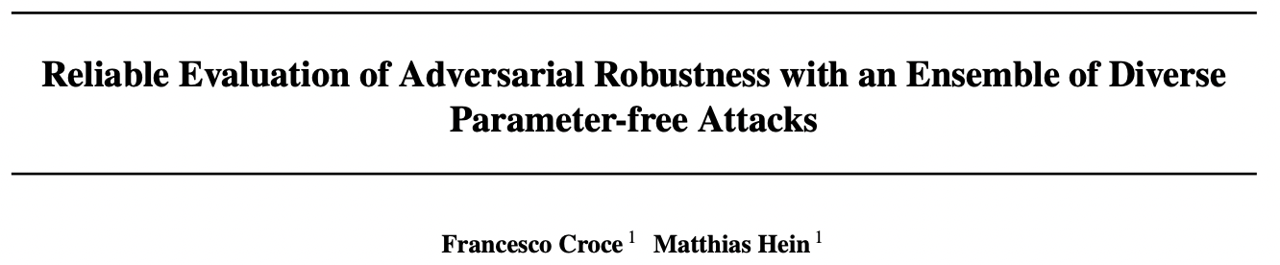
Today: refuting a defense = building an attack.

Slide 6
What’s next? Breaking 100 defenses?
11 defenses
10 defenses
7 defenses
13 defenses
35 defenses

Slide 7

This is not how we refute theorems!
Here’s an efficient algorithm for 3-SAT!

Slide 8
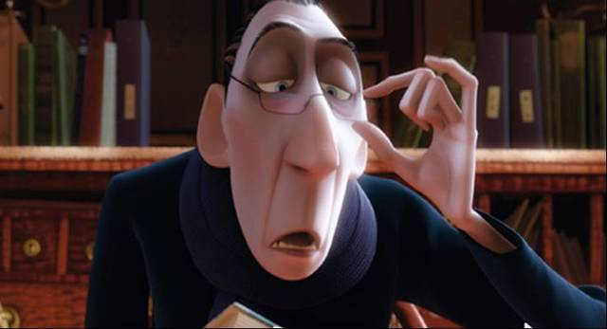
Instead, we just refute the proof.
There’s a flaw in line 637...
REJECT!

Slide 9
Similarly, we should focus on refuting ML defense evaluations.
My is robust.
This evaluation is unconvincing because...
Conclusion: NOT ROBUST

Slide 10

What makes an evaluation convincing?
My is robust.

Slide 11
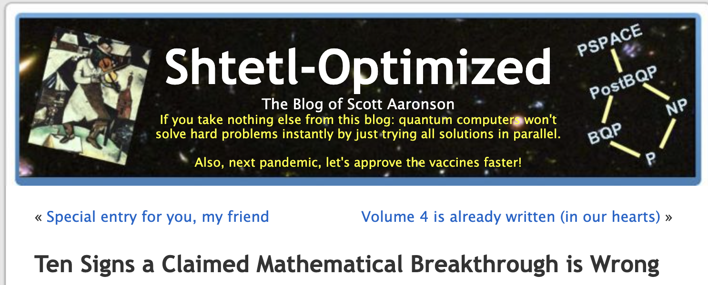

What makes a proof convincing?

Slide 12
The authors don’t use TeX.
The authors don’t understand the question.
The approach seems to yield something much stronger and maybe even false.
The approach conflicts with a known impossibility result.
The authors themselves switch to weasel words by the end.
The paper jumps into technicalities without presenting a new idea.
The paper doesn’t build on (or in some cases even refer to) any previous work.
The paper wastes lots of space on standard material.
The paper waxes poetic about “practical consequences”.
The techniques just seem too wimpy for the problem at hand.

Slide 13
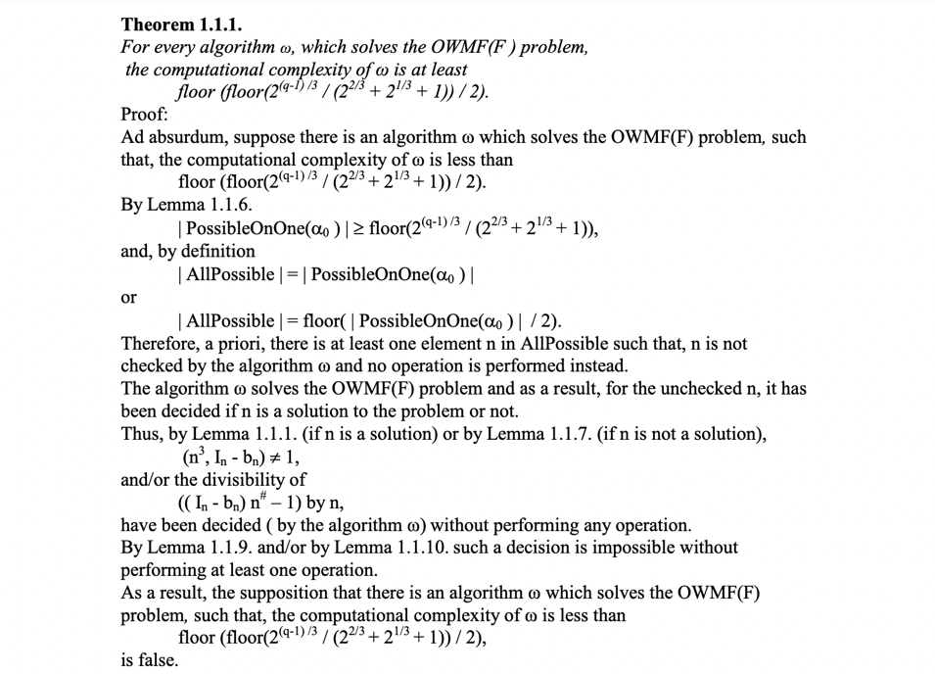
Some of these don’t really apply to ML...
1. The authors don’t use TeX.

Slide 14
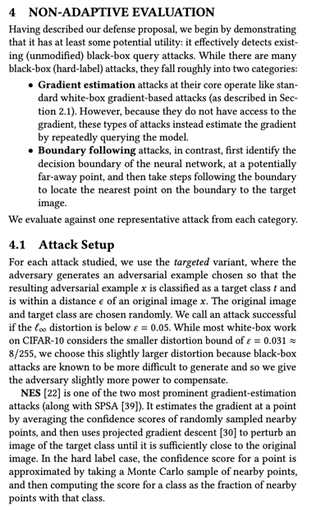
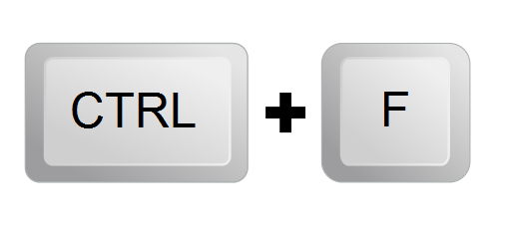
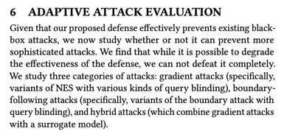
Four
Robustness
1. There is no proof.
“sanity checks that the theorem isn’t completely wrong...”
adaptive
this paper’s adaptive evaluation is actually 6x longer than its non-adaptive evaluation ☺
“actual proof!”

Slide 15

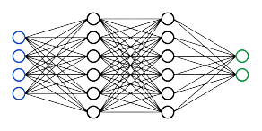
Four
Robustness
1. There is no proof.
Proof. The proof will be released upon paper acceptance.
◼️
reproducible evaluation
code
pretrained models

Slide 16
Four
Robustness
2. There are many proofs.
A strong evaluation should be about quality, not quantity

Slide 17
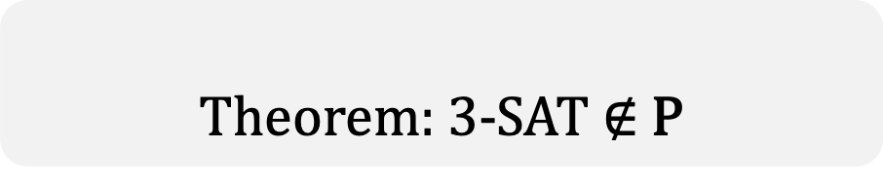

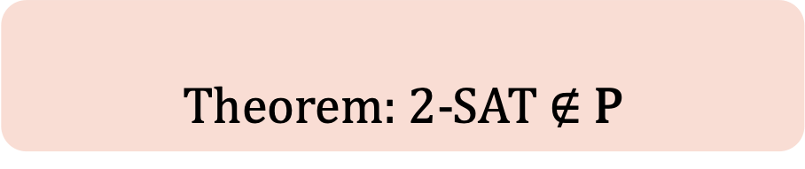
3. The approach seems to yield something much stronger and maybe even false.
Theorem: 3-SAT $∉$ P
Theorem: 2-SAT $∉$ P
$(x_{1}⋁ x2 ⋁ x3)$ $⋀$ (${¬x}_{1}⋁ ¬x2 ⋁ x4$) $⋀$ (${¬x}_{3}⋁ ¬x4 ⋁ x7$)
$(x_{1}⋁ x2)$ $⋀$ (${¬x}_{1}⋁ x3$) $⋀$ (${¬x}_{3}⋁ x5$)
Proof
If the proof still works
for a theorem that is false,
there is clearly something wrong!

Slide 18
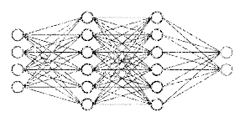
Four
Robustness
3. The approach seems to yield something much stronger and maybe even false.
is robust
is robust
Evaluation
If the evaluation still passes (all attacks fail)
for a defense that is broken,
there is clearly something wrong!

Slide 19
Building a minimally-altered, broken defense: the binarization test.
?
is robust
is robust
“Increasing Confidence in Adversarial Robustness Evaluations”, Zimmermann et al., https://arxiv.org/abs/2206.13991

Slide 20
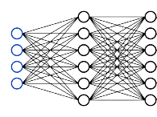

Building a minimally-altered, broken defense: the binarization test.
is robust
is robust
“Increasing Confidence in Adversarial Robustness Evaluations”, Zimmermann et al., https://arxiv.org/abs/2206.13991

Slide 21
Building a minimally-altered, broken defense: the binarization test.
is robust
is robust
Evaluation
If the evaluation were strong
it would break the non-robust defense
“Increasing Confidence in Adversarial Robustness Evaluations”, Zimmermann et al., https://arxiv.org/abs/2206.13991

Slide 22
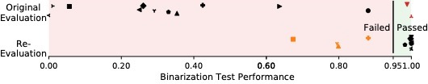
The binarization test identifies flawed evaluations.
13 defenses where the original evaluation overestimated robustness, compared to a future re-evaluation
“Increasing Confidence in Adversarial Robustness Evaluations”, Zimmermann et al., https://arxiv.org/abs/2206.13991

Slide 23

Weak evaluations fail the test.
“Increasing Confidence in Adversarial Robustness Evaluations”, Zimmermann et al., https://arxiv.org/abs/2206.13991

Slide 24
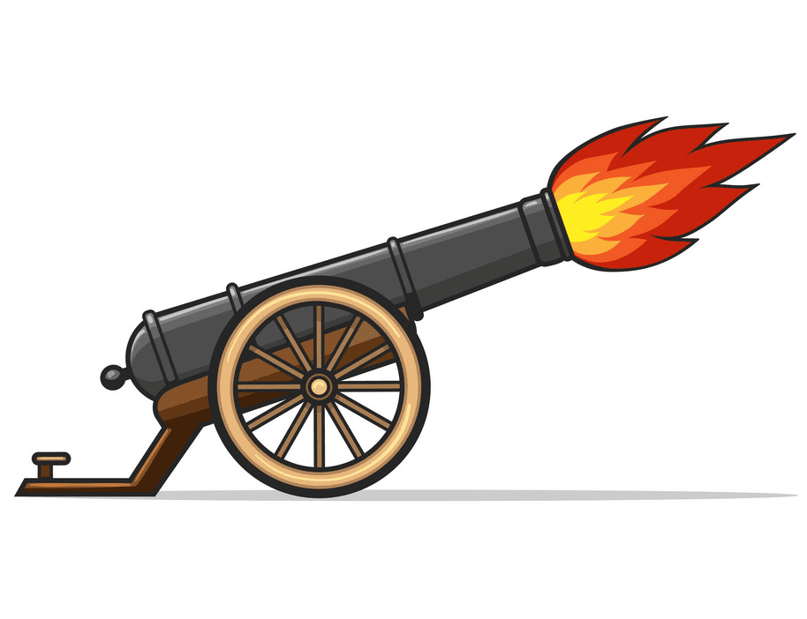
Strong adaptive evaluations (which broke the defenses) pass the test.
“Increasing Confidence in Adversarial Robustness Evaluations”, Zimmermann et al., https://arxiv.org/abs/2206.13991

Slide 25

Some adaptive attacks break defenses but remain quite weak.
“Increasing Confidence in Adversarial Robustness Evaluations”, Zimmermann et al., https://arxiv.org/abs/2206.13991

Slide 26
Our test can have false positives.
original evaluations are not “completely wrong”
“Increasing Confidence in Adversarial Robustness Evaluations”, Zimmermann et al., https://arxiv.org/abs/2206.13991

Slide 27

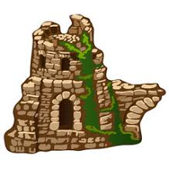

A convincing evaluation should distinguish robust defenses from broken ones!
Four
Robustness
3. The evaluation fails to break a non-robust defense.
???
Notes:
a convincing proof distinguishes correct theorems from incorrect ones

Slide 28
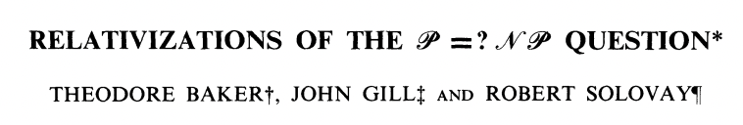
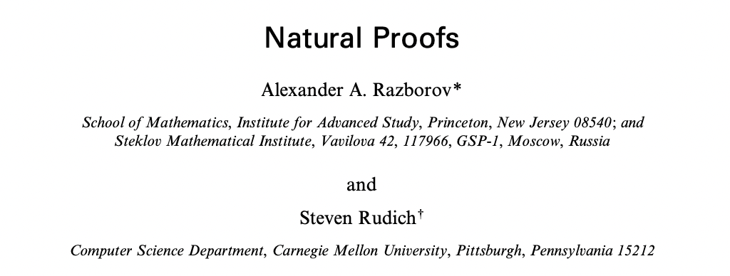
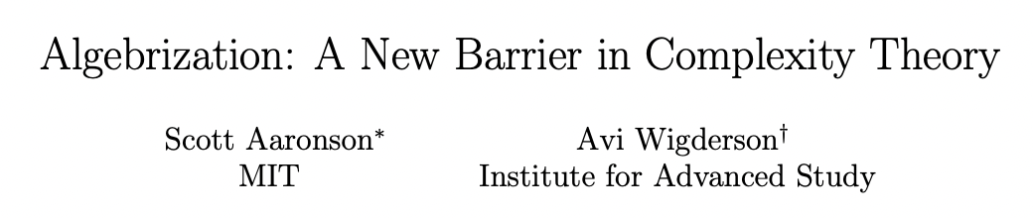
4. The approach conflicts with a known impossibility result.
Theorem:
Technique X
won’t help you solve P vs NP

Slide 29
Can we show such an impossibility result for adversarial ML?
Theorem:
Technique X
won’t help you build a robust model

Slide 30
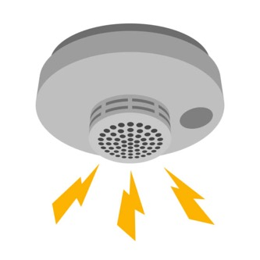
One attempt: a barrier for detecting adversarial examples.
Theorem:
Detecting attacks won’t help you build a robust model
abstain
ε
correct
abstain
“Detecting Adversarial Examples Is (Nearly) As Hard As Classifying Them”, ICML 2022, https://arxiv.org/abs/2107.11630
Notes:
and these are the types of defenses we’ll be concerned with here.
We’ll call such a detector defense robust on a given input from the distribution if it classifies the clean input correctly, and either correctly classifies *or abstains* on any perturbed version of the input within some distance epsilon

Slide 31
We show a reduction from robust detection to classification.
Robust detector
reduction
Robust
classifier
detector
Clean
Adv.
Clean
Adv.
Notes:
More precisely, we show that given a robust detector, we can build a classifier (that uses this detector as a subroutine) and which has the same clean and robust accuracy as the detector did.
And thus both problems are equally hard.

Slide 32
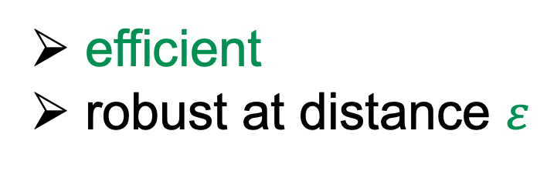
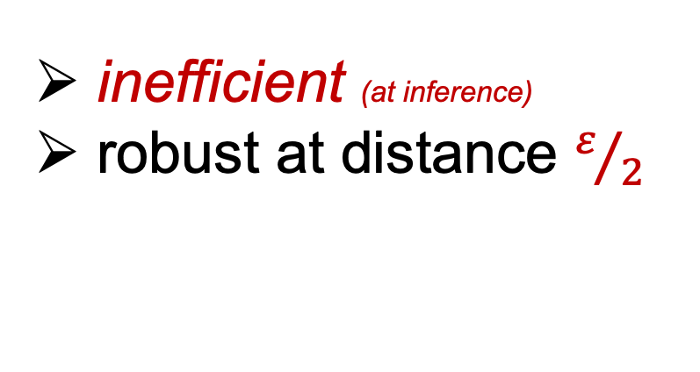
We show a partial reduction from robust detection to classification.
Robust detector
reduction
Robust
classifier
detector
efficient
robust at distance $ε$
inefficient (at inference)
robust at distance $ε/2$
Notes:
Or actually “nearly” as hard (which you might recall from the title of the talk)
Because our reduction is not quite perfect.
-> Firstly, and most importantly, the reduction is inefficient. What that means is that if you start with a robust detector that is efficient (by which we mean poly time), the classifier we build from it will not run in polynomial time. So the reduction only holds information theoretically, and not computationally.
-> And second, we lose a factor 2 in the robustness size. If the detector has 80% robust accuracy for perturbations of some size epsilon, the classifier will have at least the same robust accuracy of 80% but for perturbations of half the size.
-> From a technical perspective, the reduction and proof are actually quite simple. It relies on a standard minimum distance decoding argument from coding theory. I invite you to look at the paper if you’re interested in the details.

Slide 33

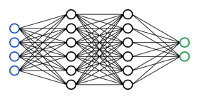
Strongly robust detectors imply a breakthrough in robust classification.
train
inference
World 1:
Clean
Adv.
Notes:
The way I like to interpret this reduction, is that we can now view any result that claims high robust accuracy with detection as also claiming a breakthrough result in robust classification.
-> To better illustrate this, we’ll consider the problem of building a robust imagenet classifier in one of two worlds.
The first, world 1, is our world. Here, you get to use the ImageNet training set to train a model and both the training and inference have to be efficient of course. And for this experiment, we just can’t seem to get very high robustness yet, using our current techniques.

Slide 34
Strongly robust detectors imply a breakthrough in robust classification.
inefficient
?
train
inference
World 2:
Clean
Adv.
Can we build much more robust classifiers in World 2?
(we don’t know...)
Notes:
Now the second world, world 2, is exactly the same, except that here the model’s inference procedure is allowed to be inefficient. But everything else is unchanged, you can’t use more training data, the training still has to be efficient. And you can’t use a bigger model either (and so in particular you can't just store the entire imagenet training set in the model in order to take full advantage of the unlimited computation you get at inference time)
-> Now the question here is: should we expect much more robust classifiers in world 2, than in our world 1. In other words, Could we somehow build much more robust classifiers just by using significantly more compute-power at inference time?
We don’t know the answer to this question, but there’s some evidence to suggest that the answer is no.
And I would view a positive answer to this question as a big breakthrough in robust classification.

Slide 35
Strongly robust detectors imply a breakthrough in robust classification.
inefficient
?
train
inference
World 2:
Clean
Adv.
Can we build much more robust classifiers in World 2?
(we don’t know...)
But any sufficiently robust detector implies a positive answer!
Notes:
But by our reduction, any robust detector implies a positive answer to this question.
And so whenever someone claims to have build a very robust detector, they are also actually claiming an breakthrough on this fundamental question about robust classification.

Slide 36

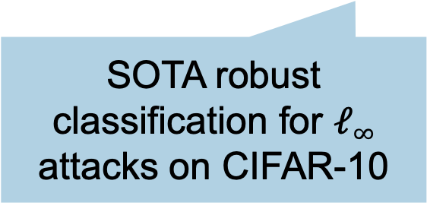
Many detectors implicitly claim such a breakthrough!
robustness claims from detector defenses
SOTA robust classification for $ℓ∞$ attacks on CIFAR-10
Notes:
As it turns out, many detector defenses implicitly claim such a breakthrough.
Here on this graph, I’m showing in blue the best known results for robust *classification* on CIFAR-10. These results have been independently re-evaluated multiple times, with great care, and so we have good confidence that this is currently the best we know how to do.
In red are the robust accuracies claimed by three different detector defenses from the past years. In the paper, we look at 13 such results.
Because these defenses merely have to detect attacks, they claim to be much more robust than existing robust classifiers.

Slide 37
Many detectors implicitly claim such a breakthrough!
our reduction implies a robust classifier for ε/2
Notes:
But by our reduction, we know that these detectors imply a robust classifier as well, for half the perturbation size.

Slide 38
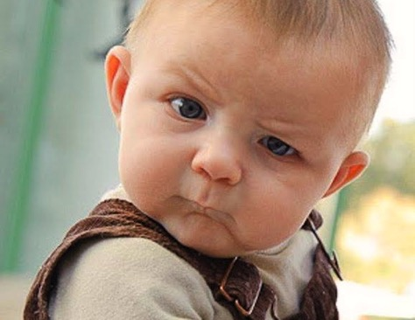
Optimistic view: this is a breakthrough in (inefficient) robust classification!
Notes:
And so know we have these implicit claims of huge improvements in robust classification (if the inference phase can be inefficient).
So the optimistic take here would be: waouh, this is a huge breakthrough.
But we should be somewhat skeptical of this, due to how hard we believe such a result would be to achieve.

Slide 39

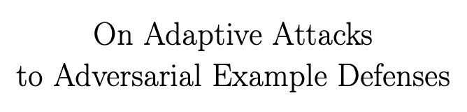
Pessimistic (realistic?) view:
These detectors are not robust!
Notes:
And for me at least, the more realistic interpretation is the pessimistic one: namely that the robustness claims from these detector defenses are simply wrong.
And in fact, for some of the defenses we looked at here, we know this to be the case.
For example, the right-most detector defense here, which would imply an extremely robust classifier, is actually not robust at all when evaluated with a stronger attack.
For the other two, I don’t know for sure, they haven’t yet been independently re-evaluated. But our reduction serves as a strong indicator that these robustness claims are also over-estimated.

Slide 40
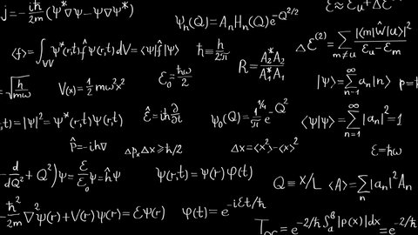
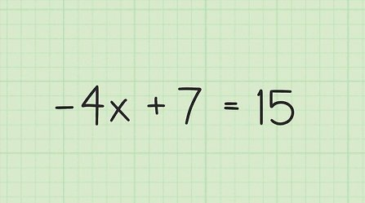
Robust detection is as hard as classification.
Robust classification
Robust detection
Notes:
In summary, in this work we show that robust detection of adversarial examples isn’t actually much easier than directly classifying them.

Slide 41
Robust detection is as hard as classification.
Robust classification
Robust detection
Notes:
In summary, in this work we show that robust detection of adversarial examples isn’t actually much easier than directly classifying them.

Slide 42

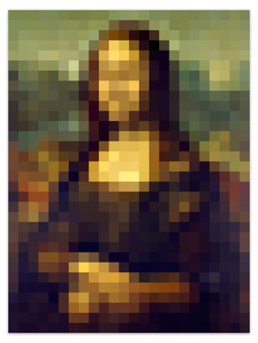
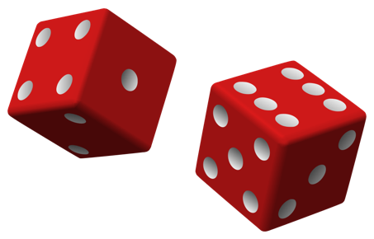
Four
Robustness
4. Breakthrough results using only “weak” techniques.
denoisers,
preprocessors
detectors
randomness
provably weak!
empirically weak

Slide 43
Treat your ML defense like a theorem!
Defense evaluations that aren’t convincing are like theorems without proofs...
Four
Robustness
There is no adaptive attack (or no code). (no proof)
There are many partial adaptive attacks. (many proofs)
The evaluation fails to break a non-robust defense. (proof idea still holds for false theorems)
Breakthrough results using only “weak” techniques. (proof idea is believed/known to fail)
Notes:
conjecture!

