Slide 1
Limitations of Threat Modeling in Adversarial Machine Learning
Florian Tramèr
EPFL, December 19th 2019
Based on joint work with Jens Behrmannn, Dan Boneh,
Nicholas Carlini, Pascal Dupré, Jörn-Henrik Jacobsen,
Nicolas Papernot, Giancarlo Pellegrino, Gili Rusak

Slide 2

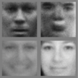
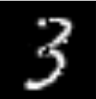

The state of adversarial machine learning
GANs vs Adversarial Examples
Maybe we need to write 10x more papers
10000+ papers
2013
2014
2018
2019
1000+ papers
Inspired by N. Carlini, “Recent Advances in Adversarial Machine Learning”, ScAINet 2019
Notes:
A few words on the title “adv. ML” which is a little overloaded. And this is a bit of an issue even at ML conferences when assigning topics to papers.
Adv ML means either GANs or adversarial examples.
And to set the tone for this talk, it’s actually illustrative to look at how these two fields have evolved over the past few years.

Slide 3
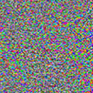
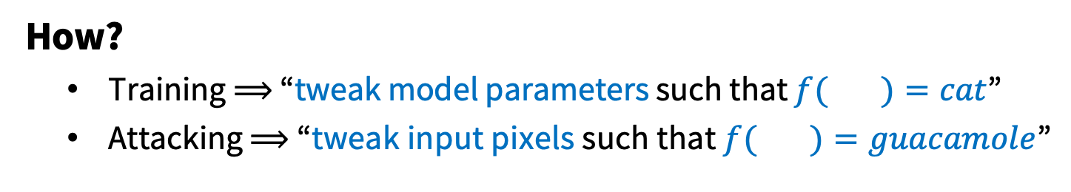
Adversarial examples
Biggio et al., 2014
Szegedy et al., 2014
Goodfellow et al., 2015
Athalye, 2017
88% Tabby Cat
99% Guacamole
  How?
    Training ⟹ “tweak model parameters such that $f( )=cat$”
    Attacking ⟹ “tweak input pixels such that $f( )=guacamole$”

Slide 4
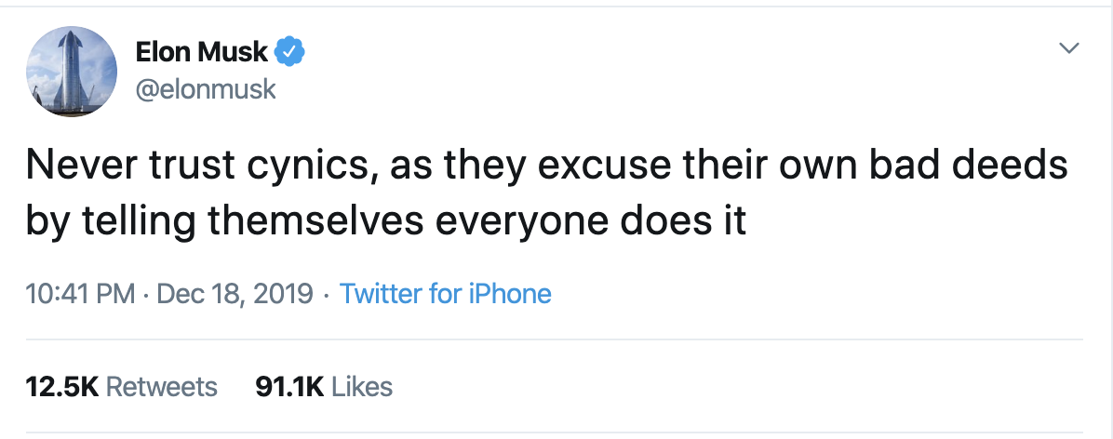
The bleak state of adversarial examples
Notes:
Title / outline is a little pessimistic and cynical.
First a timely word of caution from Elon Musk. Just a few hours ago.
And this hit a little close to home in that this talk (and my outlook on many things) tends to be quite cynical.
But Elon is right in that many of the things I’ll criticize in this talk are things that myself and many others in this field have fallen for.
If anything relates to work you’ve done. Don’t take it too personally.
But I hope that we, as a field, can reflect on the issues I’ll raise here. Because ultimately ML security and safety will be one of the grand challenges we’ll face.

Slide 5
The bleak state of adversarial examples
Most papers study a “toy” problem
Solving it is not useful per se, but maybe we’ll find new insights or techniques
  Going beyond this toy problem (even slightly) is hard
  Overfitting to the toy problem happens and is harmful
  The “non-toy” version of the problem is not actually that relevant for computer security
  (except for ad-blocking)

Slide 6
The bleak state of adversarial examples
Most papers study a “toy” problem
Solving it is not useful per se, but maybe we’ll find new insights or techniques
  Going beyond this toy problem (even slightly) is hard
  Overfitting to the toy problem happens and is harmful
  The “non-toy” version of the problem is not actually that relevant for computer security
  (except for ad-blocking)

Slide 7
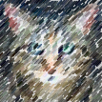

The standard game [Gilmer et al. 2018]
Adversary is given an input x from a data distribution
Adversary has some info on model
(white-box, queries, data)
ML Model
Adversary produces adversarial example x’
Adversary wins if x’ ≈ x and defender misclassifies

Slide 8
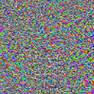
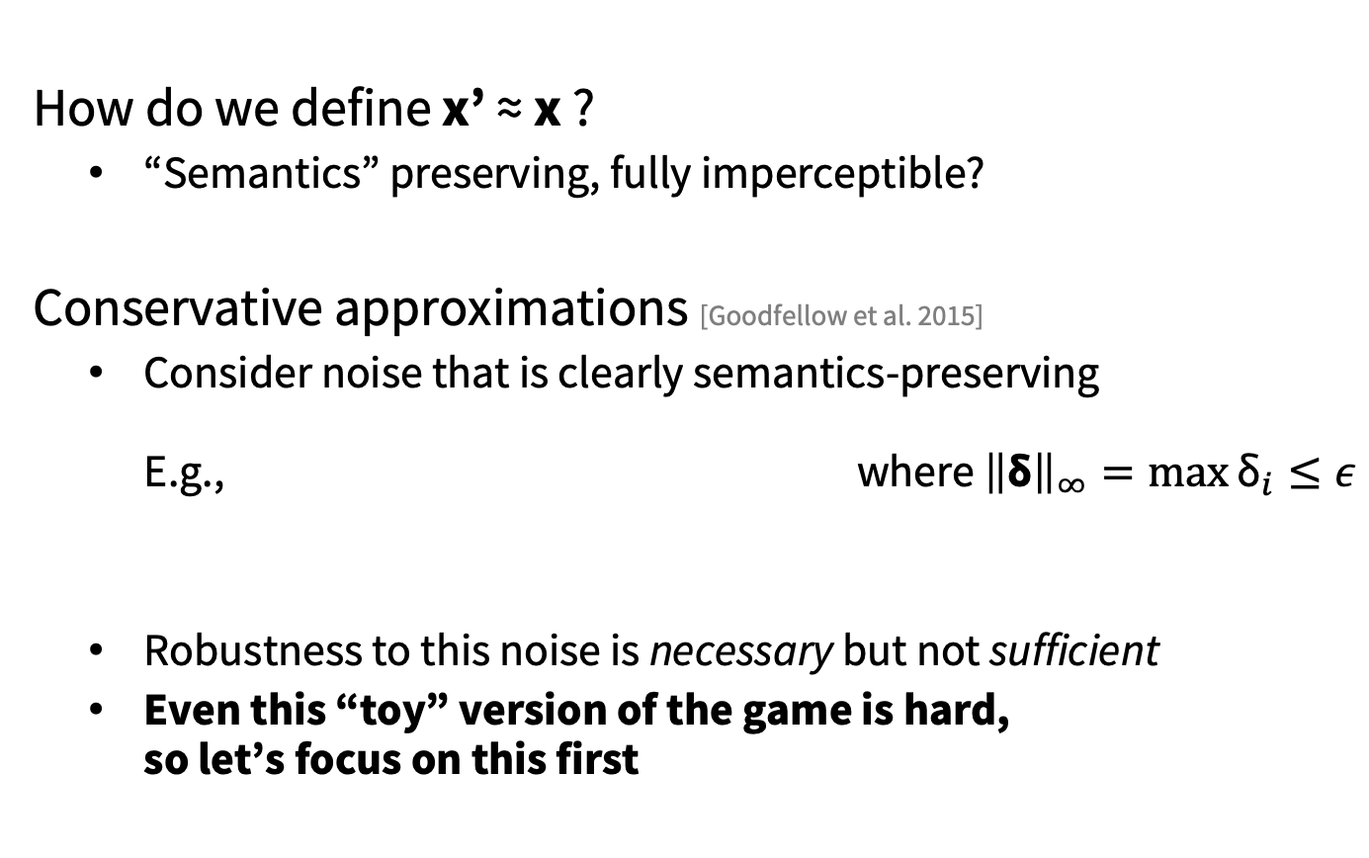
Relaxing and formalizing the game
  How do we define x’ ≈ x ?
    “Semantics” preserving, fully imperceptible?
  Conservative approximations [Goodfellow et al. 2015]
    Consider noise that is clearly semantics-preserving
    E.g., where ${\left\|\text{δ}\right\|}_{∞}=\max{{\text{δ}}_{i}≤ε}$
    Robustness to this noise is necessary but not sufficient
    Even this “toy” version of the game is hard,
    so let’s focus on this first
x’
x
δ
Notes:
Nothing forces the adversary to use that type of noise

Slide 9
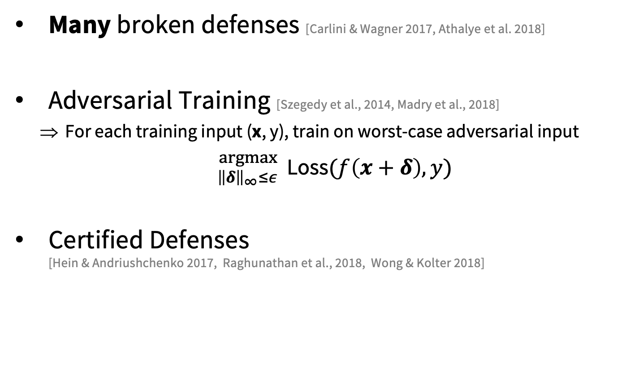
Progress on the toy game
Many broken defenses [Carlini & Wagner 2017, Athalye et al. 2018]
Adversarial Training [Szegedy et al., 2014, Madry et al., 2018]
    For each training input (x, y), train on worst-case adversarial input
    ${}_{{\left\|δ\right\|}_{∞}≤ε}^{argmax}{ \text{Loss}(f\left(x+δ\right), y)}$
Certified Defenses
[Hein & Andriushchenko 2017, Raghunathan et al., 2018, Wong & Kolter 2018]

Slide 10
Progress on the toy game
Robustness to noise of small
l_{p} norm is a “toy” problem
Solving this problem is not useful per se, unless it teaches us new insights
Solving this problem does not give us “secure ML”
Many broken defenses [Carlini & Wagner 2017, Athalye et al. 2018]
Adversarial Training [Szegedy et al., 2014, Madry et al., 2018]
    For each training input (x, y), train on worst-case adversarial input
    ${}_{{\left\|δ\right\|}_{∞}≤ε}^{argmax}{ \text{Loss}(f\left(x+δ\right), y)}$
Certified Defenses
[Hein & Andriushchenko 2017, Raghunathan et al., 2018, Wong & Kolter 2018]

Slide 11
Outline
Most papers study a “toy” problem
Solving it is not useful per se, but maybe we’ll find new insights or techniques
  Going beyond this toy problem (even slightly) is hard
  Overfitting to the toy problem happens and is harmful
  The “non-toy” version of the problem is not actually that relevant for computer security
  (except for ad-blocking)

Slide 12

Beyond the toy game
  Issue: defenses do not generalize
  Example: training against l∞-bounded noise on CIFAR10
Engstrom et al., 2017
Sharma & Chen, 2018
No noise
l∞ noise
l₁ noise
rotation / translation
Robustness to one type can increase vulnerability to others
Notes:
So why is it hard to go beyond the toy problem.
The main issue, is that existing defenses (such as Adv Training) overfit to the specific way that we approximate “small perturbations”.
Case in point,

Slide 13



Robustness to more perturbation types
S₁ = $\left\{δ: {\left\|δ\right\|}_{∞}≤ ε_{∞}\right\}$
S₂ = $\left\{δ: {\left\|δ\right\|}_{1}≤ ε_{1}\right\}$
S₃ = $\left\{δ:«\text{small} \text{rotation}»\right\}$
S = S₁ U S₂ U S₃
Pick worst-case adversarial example from S
Train the model on that example
T & Boneh, “Adversarial Training and Robustness for Multiple Perturbations”, NeurIPS 2019
Notes:
In a recent paper with Dan, we looked at the simple and natural question
whether we could extend existing defenses to handle multiple types of perturbations simultaneously
We still need to fix perturbations ahead of time. So this still wouldn’t be enough from a security perspective.
But it can teach us something about the scalability of existing defenses such as adversarial training

Slide 14
Empirical multi-perturbation robustness
CIFAR10:
MNIST:
T & Boneh, “Adversarial Training and Robustness for Multiple Perturbations”, NeurIPS 2019
Notes:
Results a little bleak.

Slide 15
Empirical multi-perturbation robustness
Current defenses scale poorly to multiple perturbations
We also prove that a robustness tradeoff is inherent for simple data distributions
CIFAR10:
MNIST:
T & Boneh, “Adversarial Training and Robustness for Multiple Perturbations”, NeurIPS 2019
Notes:
As long as models only learn superficial stats instead of high-level features, this might be inherent

Slide 16
Outline
Most papers study a “toy” problem
Solving it is not useful per se, but maybe we’ll find new insights or techniques
  Going beyond this toy problem (even slightly) is hard
  Overfitting to the toy problem happens and is harmful
  The “non-toy” version of the problem is not actually that relevant for computer security
  (except for ad-blocking)
Notes:
We’ve seen that going beyond the toy problem is hard
So instead, there’s been a trend of papers trying to improve results on the toy problem
ML obsession with SOTA results: give a metric and people will optimize it. Or people will just invent a metric to optimize

Slide 17

Invariance adversarial examples
  Highest robustness claims in the literature:
    80% robust accuracy to l₀ = 30
    Certified 85% robust accuracy to l ∞ = 0.4
$$∈\left\{0, 1\right\}784$$
natural
Robustness considered harmful
l∞ ≤ 0.4
l₀ ≤ 30
Jacobsen et al., “Exploiting Excessive Invariance caused by Norm-Bounded Adversarial Robustness”, 2019
Notes:
MNIST if considered a really easy task.
So we can actually achieve very high robustness to some types of noise
Several papers that report results of >0% accuracy for eps=0.5. This is an issue of evaluation

Slide 18
Invariance adversarial examples
  Highest robustness claims in the literature:
    80% robust accuracy to l₀ = 30
    Certified 85% robust accuracy to l ∞ = 0.4
We do not even know how to set the “right” bounds for the toy problem
$$∈\left\{0, 1\right\}784$$
natural
Robustness considered harmful
l∞ ≤ 0.4
l₀ ≤ 30
Jacobsen et al., “Exploiting Excessive Invariance caused by Norm-Bounded Adversarial Robustness”, 2019

Slide 19
Adversarial examples are hard!
  Most current work: small progress on the relaxed game
  Moving towards the standard game is hard
    Even robustness to 2-3 perturbations types is tricky
    How would we even enumerate all necessary perturbations?
  Over-optimizing robustness is harmful
    How do we set the right bounds?
  We need a formal model of perceptual similarity
    But then we’ve probably solved all of computer vision anyhow...
Notes:
25 min
So to recap this first part of the talk, the take away should really be: adversarial examples are hard.
Even though there’s been some great work on this toy problem, I think we should be careful not to have an illusion that we’re anywhere close to a solution to the standard game.
Chicken and egg problem

Slide 20
Outline
Most papers study a “toy” problem
Solving it is not useful per se, but maybe we’ll find new insights or techniques
  Going beyond this toy problem (even slightly) is hard
  Overfitting to the toy problem happens and is harmful
  The “non-toy” version of the problem is not actually that relevant for computer security
  (except for ad-blocking)
Notes:
Ok so we’ve now spent a lot of time talking about how getting models that re robust in this “standard” game is really hard.
The things that irks me most in this area, is that it’s not even clear if this the right problem to be solving in the first place, in so far as ML security is concerned.

Slide 21
Recap on the standard game
Adversary is given an input x from a data distribution
Adversary has some info on model
(white-box, queries, data)
ML Model
Adversary produces adversarial example x’
Adversary wins if x’ ≈ x and defender misclassifies

Slide 22
Recap on the standard game
There are very few settings where this game captures a relevant threat model
Adversary is given an input x from a data distribution
Adversary has some info on model
(white-box, queries, data)
ML Model
Adversary produces adversarial example x’
Adversary wins if x’ ≈ x and defender misclassifies

Slide 23
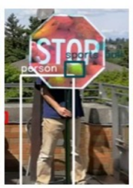
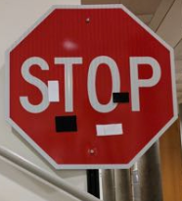
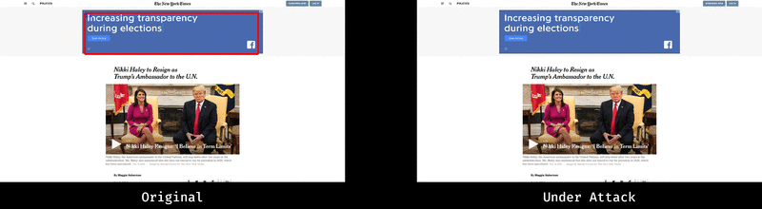
ML in security/safety critical environments
Fool self-driving cars’ street-sign detection
[Eykholt et al. 2017+2018]
Evade malware detection
[Grosse et al. 2018]
Fool visual ad-blockers
[T et al. 2019]

Slide 24

Is the standard game relevant?

Slide 25
ML Model

Slide 26
Is the standard game relevant?
  Is there an adversary?
Notes:
Paraphrase James Mickens who had this funny point to make about research on remotely hacking pacemakers:
If someone’s going to go to those lengths to kill you, maybe you deserved it.

Slide 27
Adversary is given an input x from a data distribution
ML Model
Notes:
Second important aspect of the game is that the adversary isn’t allowed to choose the inputs that he starts with.
There’s an assumption of a distribution of inputs that the adv has to handle.
And so implicitly, what we care about is avg success

Slide 28
Is the standard game relevant?
  Is there an adversary?
  Is average-case success important?
  (Adv cannot choose which inputs to attack)
Notes:
Does the adversary have to attack a specific sign? Does he have to start with a real sign?
Also, if the attack succeeds once, you’re dead.
For malware, it’s a bit more subtle. If you’re trying to emulate an existing popular app, you have to start from an existing input.
But still, you get to choose. E.g., Fortnight.
If you’re writing a malware app from scratch, you get to do whatever you want.
For ad-blocking, the attacker (e.g., a ad network or publisher) isn’t the one producing the ads. Also, if your attack only works for ads from one brand, that’s not enough.

Slide 29
Adversary has some info on model
(white-box, queries, data)
ML Model

Slide 30
Is the standard game relevant?
  Is there an adversary?
  Average-case success?
  Model access?
  (white-box, queries, data)
Notes:
For cars, maybe. You’d have to extract this somehow.
For malware, you get query access, but very slow response time and rate limited
For ad-blocking, it’s running client side

Slide 31
ML Model
Adversary wins if x’ ≈ x and defender misclassifies

Slide 32
Is the standard game relevant?
  Is there an adversary?
  Average-case success?
  Access to model?
  Should attacks preserve semantics?
  (or be fully imperceptible)
Notes:
If you really want to get my car to crash, where will you stop at?
For malware, you do want an app that’s inconspicuous. If you’re emulating a real app (e.g., Facebook), you don’t want the user to notice.
For ads, you really want imperceptibility. Ads are optimized to get users to click. You don’t want to change that.

Slide 33
Is the standard game relevant?
  Is there an adversary?
  Average-case success?
  Access to model?
  Semantics-preserving perturbations?
Unless the answer to all these questions is Yes, the standard game of adversarial examples is not the right threat model

Slide 34
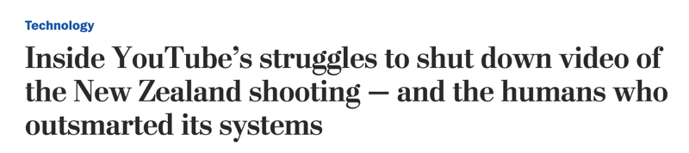
Where else could the game be relevant?
Anti-phishing
Content takedown
Common theme: human-in-the-loop!
(Adversary wants to fools ML without disrupting UX)

Slide 35
Steps forward
https://nicholas.carlini.com
Most of these papers consider the relaxed game
Progress on this game is not useful per se
For safety-critical ML (e.g., self-driving):
    There is no adversary (but worst-case analysis can be useful)
    Consider “natural” perturbations (fog, snow, lighting, angles, etc.)
For real security-critical ML (e.g., malware detection):
    Attackers often care about breaking in once
    (analyzing static classifiers is not very useful)
    Security through obscurity (restricted model access) “works” in practice

Slide 36
10000+ papers
2013
2014
2018
2019
1000+ papers
Maybe we do not need 10x more papers... just the right ones

Slide 37
Backup slides

Slide 38
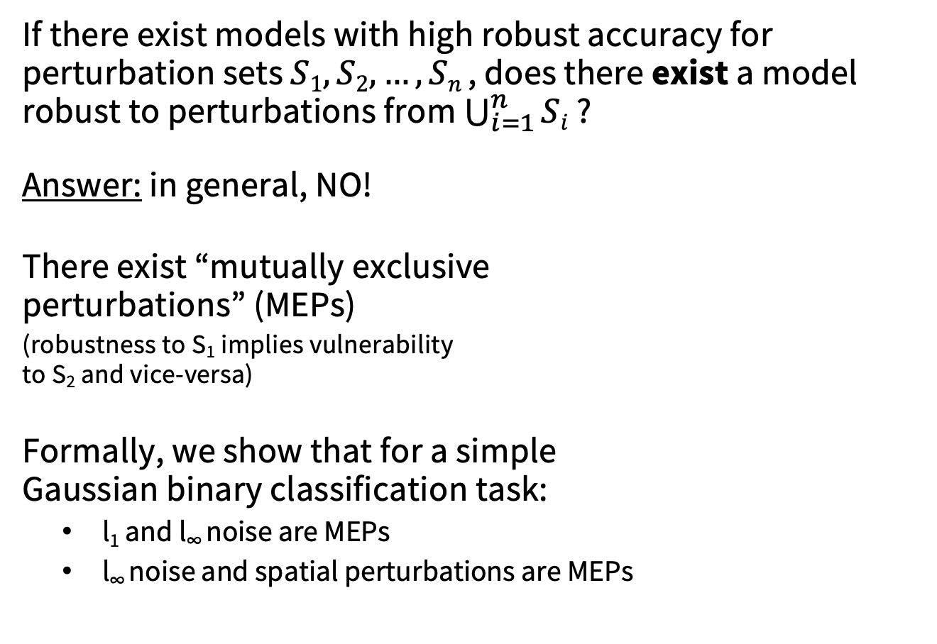
The multi-perturbation robustness trade-off
If there exist models with high robust accuracy for perturbation sets $S1, S2, …, Sn$, does there exist a model robust to perturbations from $\bigcup_{i=1}^{n}{Si}$ ?
Answer: in general, NO!
There exist “mutually exclusive
perturbations” (MEPs)
(robustness to S₁ implies vulnerability
to S₂ and vice-versa)
Formally, we show that for a simple
Gaussian binary classification task:
    l₁ and l∞ noise are MEPs
    l∞ noise and spatial perturbations are MEPs
Robust for S₁
Not robust for S₂
x₁
Classifier robust to S1
Classifier vulnerable to S1 and S2
Not robust for S₁
Robust for S₂
x₂
Classifier robust to S2
T & Boneh, “Adversarial Training and Robustness for Multiple Perturbations”, NeurIPS 2019

Slide 39
The standard game [Gilmer et al. 2018]
ML Model
Adversary is given input x from some data distribution
Adversary gets some information on model:
    Access to model parameters (white-box)
    Query access
    Access to similar training data
Adversary outputs an adversarial example x’
Defender classifies x’
Adversary wins if x’ ≈ x and defender misclassifies

