Slide 1
What's next for adversarial ML?
(and why ad-blockers should care)
Florian Tramèr
EPFL
July 9th 2018
Joint work with Gili Rusak, Giancarlo Pellegrino and Dan Boneh
Notes:
First give a brief overview of current state of research on adversarial examples.
Then I’ll discuss what we think this does (or doesn’t) mean for the future of ad blocking

Slide 2
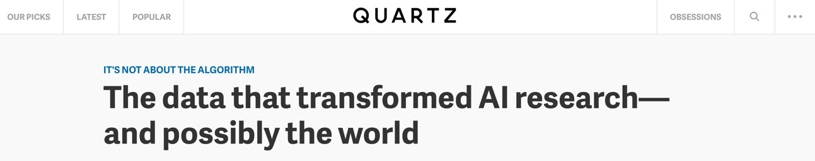
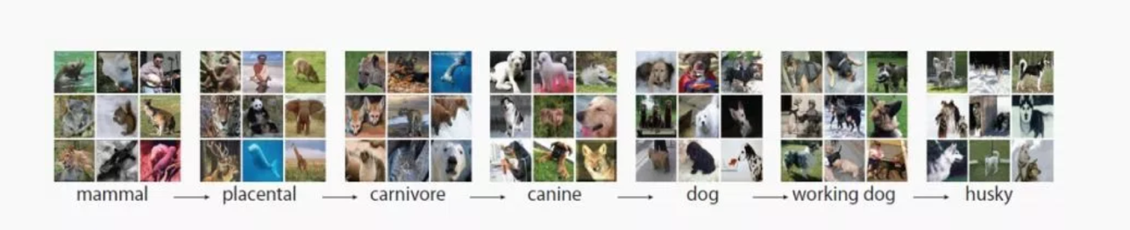
The Deep Learning Revolution
  First they came for images…
Notes:
For about 5 years, we’ve witnessed a deep learning revolution. All started with images

Slide 3
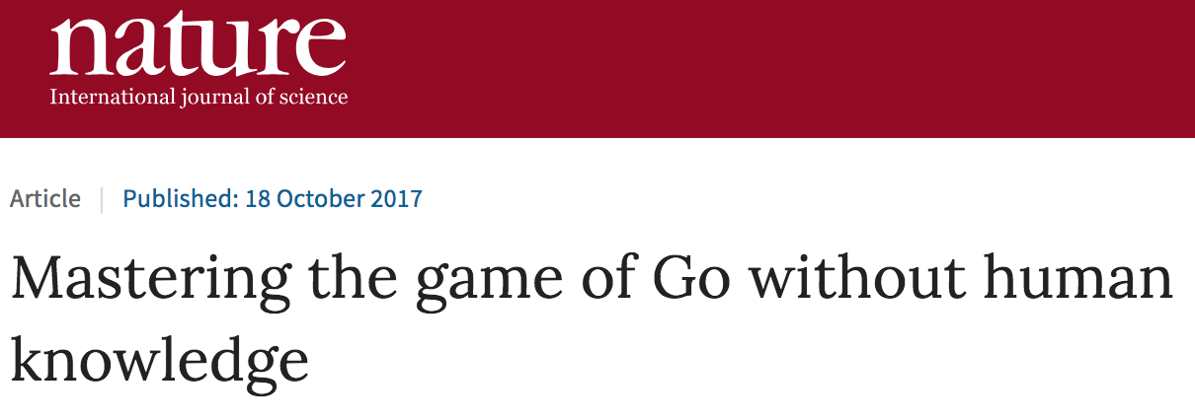
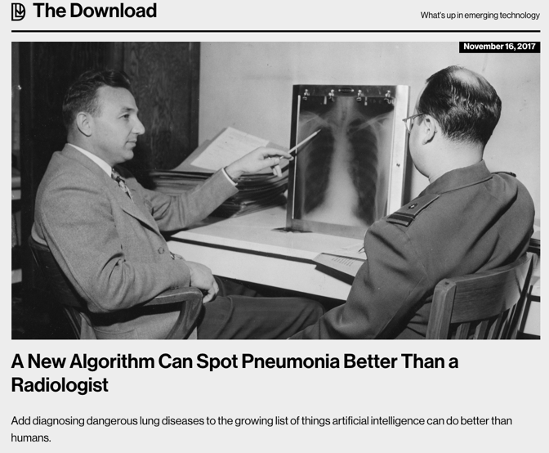
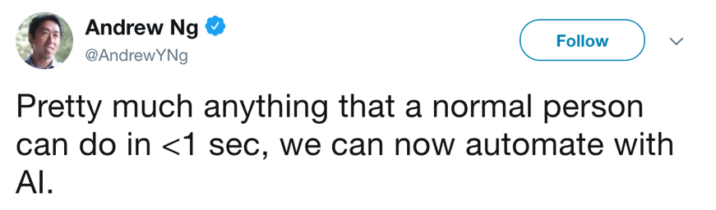
The Deep Learning Revolution
  And then everything else…
Notes:
But quickly spread to diverse areas such as game playing, self-driving cars, medicine. And not clear where this trend will end
Striking quote by Andres Ng: optimistic but sentiment is compelling

Slide 4

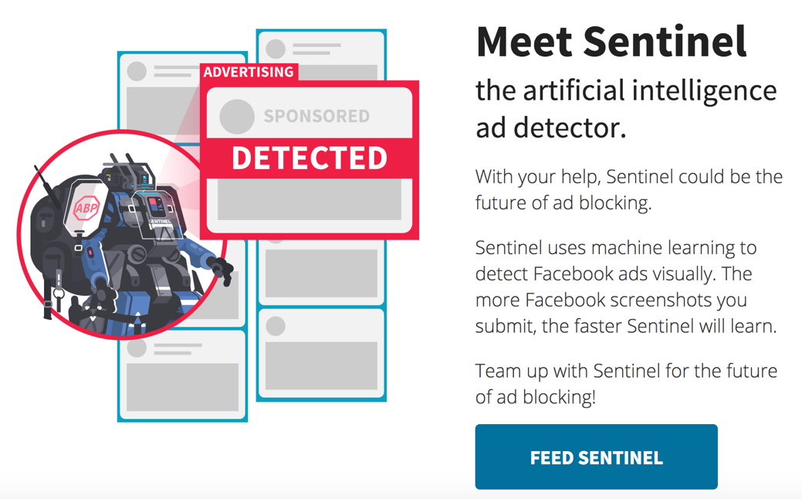
The ML Revolution
  Including things that likely won’t work…
Notes:
This view is challenged when ML is applied to security sensitive areas
Recent example: using ML to detect and block facebook ads

Slide 5
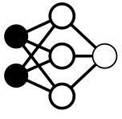


What does this mean for privacy & security?
Crypto, Trusted hardware
Differential privacy
Privacy & integrity
Outsourced learning
Data inference
Model theft [TZJRR16]
Test outputs
Training data
Data poisoning
Blockchain
???
dog
cat
bird
Robust statistics
Adversarial
Examples
Outsourced inference
Test data
Privacy & integrity
Crypto, Trusted hardware
Check out Slalom! [TB18]
Adapted from (Goodfellow 2018)
Notes:
What does this revolution mean for privacy/security researchers: A rich pipeline with hard problems at every step

Slide 6
What does this mean for privacy & security?
Crypto, Trusted hardware
Differential privacy
Privacy & integrity
Outsourced learning
Data inference
Model theft [TZJRR16]
Test outputs
Training data
Data poisoning
???
dog
cat
bird
Robust statistics
Adversarial
Examples
Outsourced inference
Test data
Privacy & integrity
Crypto, Trusted hardware
Check out Slalom! [TB18]
Adapted from (Goodfellow 2018)
Notes:
What does this revolution mean for privacy/security researchers: A rich pipeline with hard problems at every step

Slide 7
ML models make surprising mistakes
Pretty sure this is a panda
I’m certain this is a gibbon
(Szegedy et al. 2013, Goodfellow et al. 2015)

Slide 8
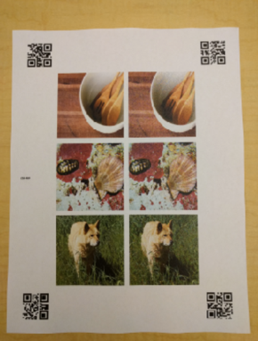
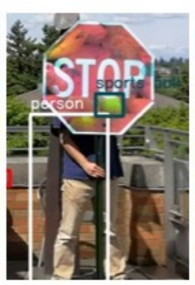
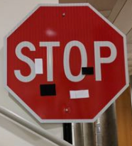
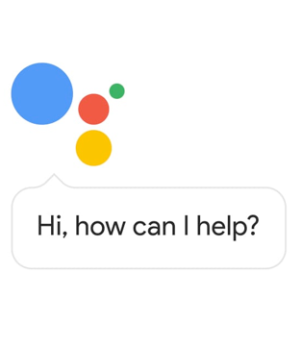
Attacks on cyber-physical systems
(Athalye et al. 2018)
(Kurakin et al. 2016)
(Sharif et al. 2016)
(Eykholt et al. 2017)
(Carlini et al. 2016,
Cisse et al. 2017)
(Eykholt et al. 2018)
Notes:
Mirroring deep learning, what started with images has quickly moved on to cover a wide range of cyber-physical systems

Slide 9
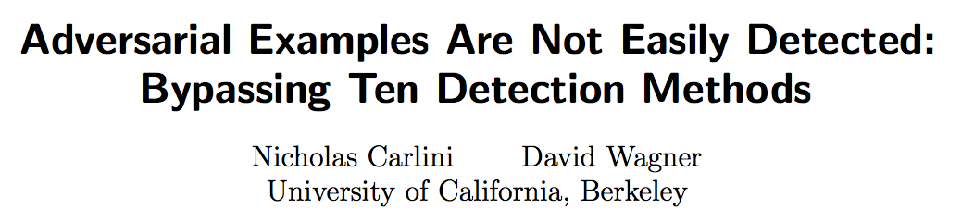
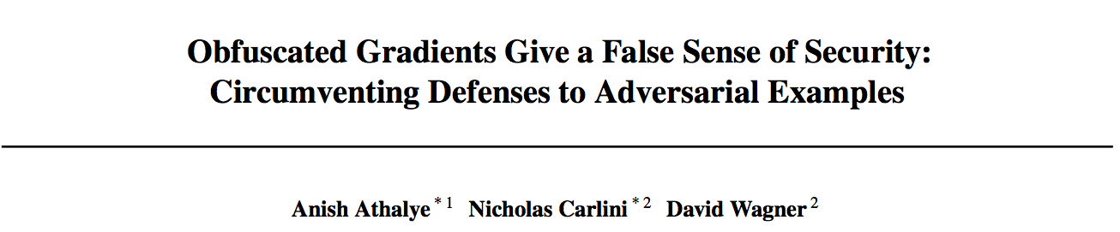
Where are the defenses?
Adversarial training
Szegedy et al. 2013, Goodfellow et al. 2015,
Kurakin et al. 2016, T et al. 2017,
Madry et al. 2017, Kannan et al. 2018
Convex relaxations with provable guarantees
Raghunathan et al. 2018, Kolter & Wong 2018, Sinha et al. 2018
A lot of broken defenses…
Prevent “all/most attacks” for a given norm ball
Notes:
Adversarial training: basically worst-case data augmentation under a given attack model. Past year has seen some first cool examples of provable defenses
9min + 3min at this point

Slide 10
Do we have a realistic threat model? (no…)
Current approach:
    Fix a ”toy” attack model (e.g., some l∞ ball)
    Directly optimize over the robustness measure
      Defenses do not generalize to other attack models
      Defenses are meaningless for applied security
What do we want?
    Model is “always correct” (sure, why not?)
    Model has blind spots that are “hard to find”
      “Non-information-theoretic” notions of robustness?
      CAPTCHA threat model is interesting to think about
Notes:
Norm balls are intellectually / academically interesting (i.e., even this is hard), but pretty irrelevant in practice
Conservative measure of perceptual similarity (low norm implies perceptual similarity)

Slide 11
Adversarial examples are here to stay!
For many things that humans can do “robustly”, ML will fail miserably!

Slide 12
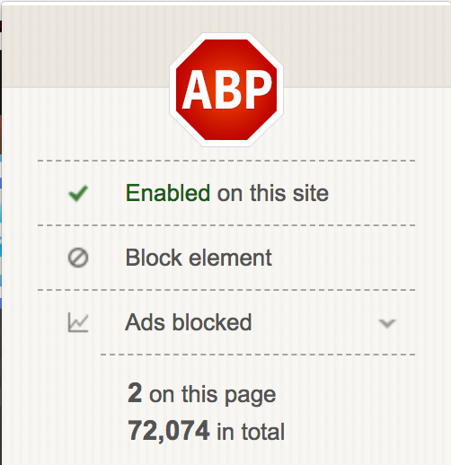
A case study on ad-blocking
Ad blocking is a “cat & mouse” game
    Ad blockers build crowd-sourced filter lists
    Ad providers switch origins
    Rinse & repeat
  (4?) Content provider (e.g., Cloudflare) hosts the ads
Notes:
Ad blocking currently: mostly no ML, detecting origin of ads, rule-based
+ 3min

Slide 13

A case study on ad-blocking
New method: perceptual ad-blocking (Storey et al. 2017)
    Industry/legal trend: ads have to be clearly indicated to humans
If humans can detect ads, so can ML!
”[…] we deliberately ignore all signals invisible to humans, including URLs and markup. Instead we consider visual and behavioral information. […] We expect perceptual ad blocking to be less prone to an "arms race."
(Storey et al. 2017)
Notes:
New idea: mirror the way humans detect ads (remember Andrew NG’s tweet, <1sec)
Storey, Reisman, Mayer, Narayanan

Slide 14


Detecting ad logos is not trivial
No strict guidelines, or only loosely followed:
Fuzzy hashing + OCR (Storey et al. 2017)
Fuzzy hashing is very brittle (e.g., shift all pixels by 1)
OCR has adversarial examples (Song & Shmatikov, 2018)
Unsupervised feature detector (SIFT)
More robust method for matching
object features (“keypoints”)
Deep object detector (YOLO)
Supervised learning
This talk
Notes:
All examples of ad-choice logos found in the wild. Different dimensions, spacing, coloring, transparency, text or no text etc.
Difficult to brute-force
YOLO => method used by Sentinel
+ 4min

Slide 15
What’s the threat model for perceptual ad-blockers?
Browser
Vivamus vehicula leo a justo. Quisque nec augue. Morbi mauris wisi, aliquet vitae, dignissim eget, sollicitudin molestie,
Content provider
Webpage
Vivamus vehicula leo a justo. Quisque nec augue. Morbi mauris wisi, aliquet vitae, dignissim eget, sollicitudin molestie,
Ad blocker
Ad network

Slide 16

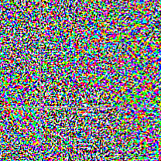

What’s the threat model for perceptual ad-blockers?
Browser
Vivamus vehicula leo a justo. Quisque nec augue. Morbi mauris wisi, aliquet vitae, dignissim eget, sollicitudin molestie,
Content provider
Webpage
Vivamus vehicula leo a justo. Quisque nec augue. Morbi mauris wisi, aliquet vitae, dignissim eget, sollicitudin molestie,
Ad blocker
Ad network
Notes:
Ad provider has incentive for ad blocker to fail, without impacting human perception of the ad: classical adversarial example problem

Slide 17

What’s the threat model for perceptual ad-blockers?
Browser
Vivamus vehicula leo a justo. Quisque nec augue. Morbi mauris wisi, aliquet vitae, dignissim eget, sollicitudin molestie,
Content provider
Webpage
Vivamus vehicula leo a justo. Quisque nec augue. Morbi mauris wisi, aliquet vitae, dignissim eget, sollicitudin molestie,
Ad blocker
Ad network
Notes:
Content provider has incentive to “punish” adblock users (as with adblock-blockers today). Ad blocker has to be robust to adversarial changes in benign content as well.

Slide 18
What’s the threat model for perceptual ad-blockers?
Pretty much the worst possible!
  Adblocker is white-box (browser extension)
    Alternative would be a privacy & bandwidth nightmare
  Adblocker operates on (large) digital images
  Adblocker needs to resist adversarial examples and “DOS” attacks
    Perturb ads to evade ad blocker
    Punish ad-block users by perturbing benign content
  Updating is more expensive than attacking
Notes:
Adblocking ticks all the boxes that make crafting adversarial examples easy
+4min

Slide 19
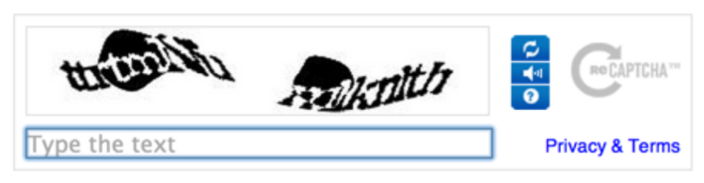
An interesting contrast: CAPTCHAs
Deep ML models can solve text CAPTCHAs
    Why don’t CAPTCHAs use adversarial examples?
    CAPTCHA ≃ adversarial example for OCR systems
 | Model access | Vulnerable to DOS | Model Distribution
Ad blocker | White-box | Yes | Expensive
CAPTCHA | “Black-box” (not even query access) | No | Cheap (None)
Notes:
Text CAPTCHAS have fallen out of fashion

Slide 20
Breaking Perceptual
Ad-Blockers with adversarial Examples

Slide 21
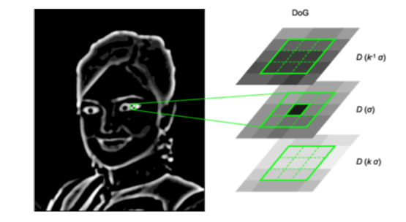
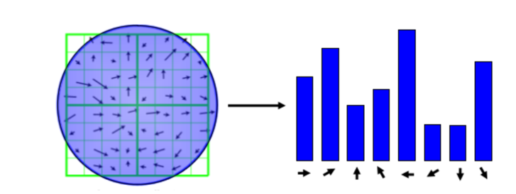
SIFT: How does it work? (I don’t know exactly either)
Notes:
Scale, rotation invariant image matching
Different gaussian smoothings: find local minima, maxima => edges, corners, etc => keypoints, descriptor for each keypoint (orientation)

Slide 22

Attack examples: SIFT detector
original ad
perturbed logo
No keypoint matches between the two logos
Attack uses standard black-box optimization
    Gradient descent with black-box gradient estimates
    There’s surely more efficient attacks but SIFT is complicated…

Slide 23
Attack examples: SIFT Denial Of Service
Logos are similar in gray scale but not in color space
Alternative: high confidence matches for visually close
—yet semantically different—objects

Slide 24
Attack examples: YOLO object detector
Object detector trained to recognize AdChoice logo
    Test accuracy is >90%
    0% accuracy with l∞ perturbations ≤ 8/256
  Similar but simpler task than Sentinel (Adblock Plus)
    Sentinel tries to detect ads in a whole webpage
    For now, it breaks even on non-adversarial inputs…

Slide 25
Perceptual ad-blockers without ad-indicators
  Hussain et al. 2017: Train a generic ad/no-ad classifier (for sentiment analysis)
    Accuracy around 88% !
    0% accuracy with l∞ perturbations ≤ 4/256
+ 0.01 ⨉
=
“Ad”
“No Ad”

Slide 26
Conclusion
Adversarial examples are here to stay
    No defense can address realistic attacks
    A truly robust defense likely implies a huge breakthrough in non-secure ML as well
  Security-sensitive ML seems hopeless if adversary has white-box model access
    Ad-blocking ticks most of the “worst-case” boxes
    ML is unlikely to change the ad-blocker
    cat & mouse game
THANKS

