Slide 1
When not to use adversarial examples
Florian Tramèr
Google Brain & ETHZ
AAAI 2022 workshop on
Adversarial Machine Learning and Beyond

Slide 2
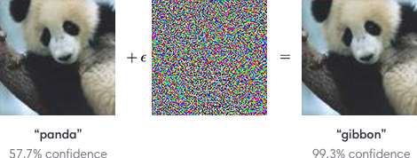
The current state of adversarial examples
All models are vulnerable to some attack
The adversary can adapt to any defense

Slide 3
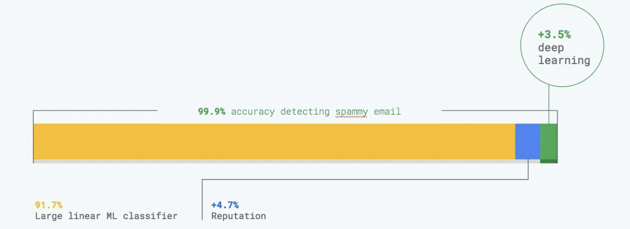

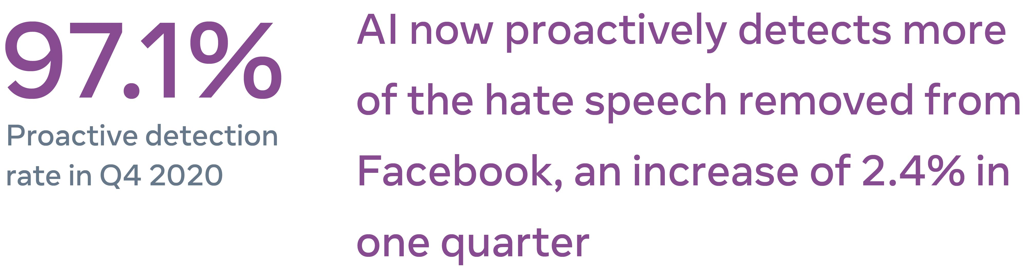
This sounds bad if you want to defend a model
All models are vulnerable to some attack
The adversary can adapt to any defense
https://elie.net/blog/ai/harnessing-ai-to-combat-fraud-and-abuse-ai-is-the-key-to-robust-defenses/
https://about.fb.com/news/2021/02/update-on-our-progress-on-ai-and-hate-speech-detection/

Slide 4
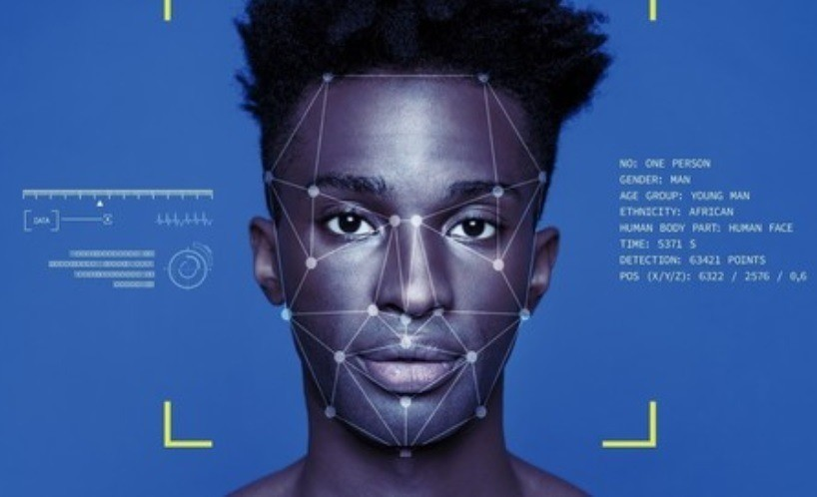

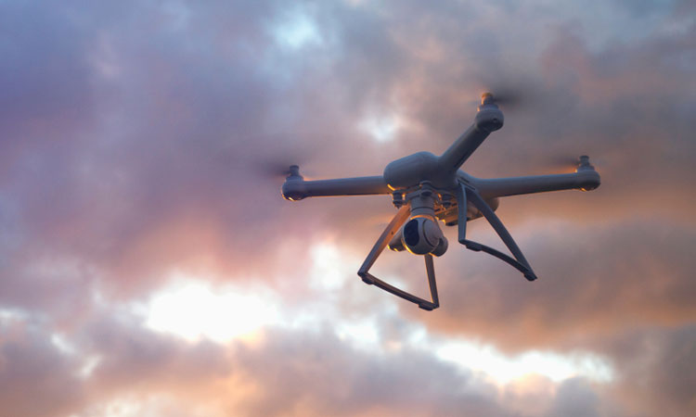
This sounds good if you want to attack a model
All models are vulnerable to some attack
The adversary can adapt to any defense

Slide 5
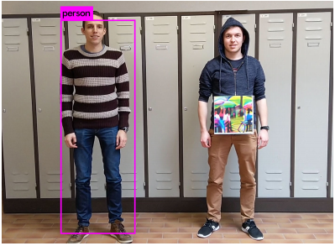
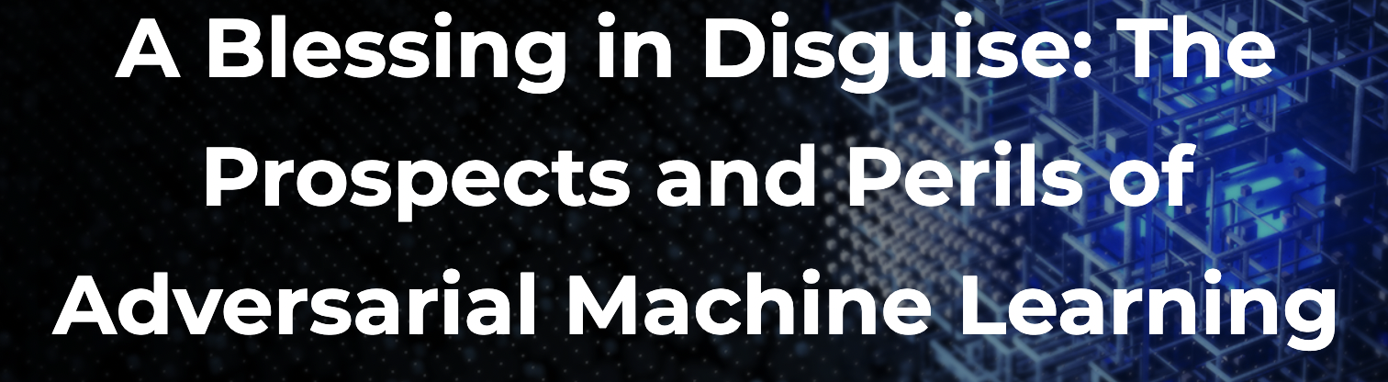
Maybe we can use adversarial examples for good!
Thys et al. 2019

Slide 6
Claim: adversarial examples don’t work for
protecting against invasive models
protecting against privacy attacks
attacking anything “real” (for now)

Slide 7
Claim: adversarial examples don’t work for
protecting against invasive models
protecting against privacy attacks
attacking anything “real” (for now)

Slide 8


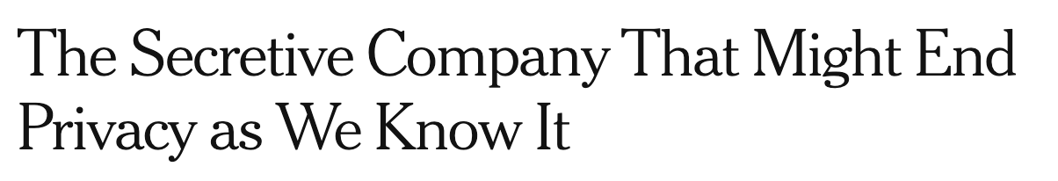
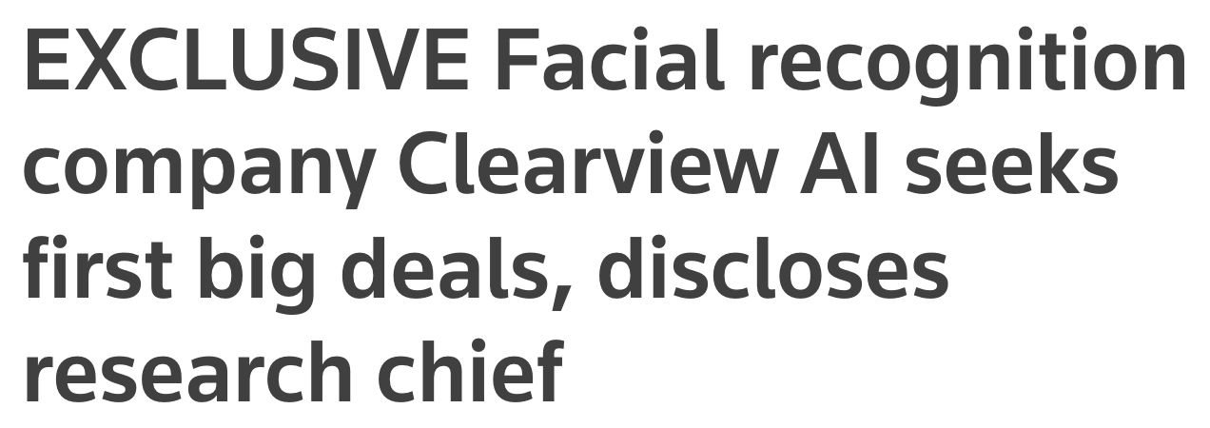
Big brother is watching you

Slide 9
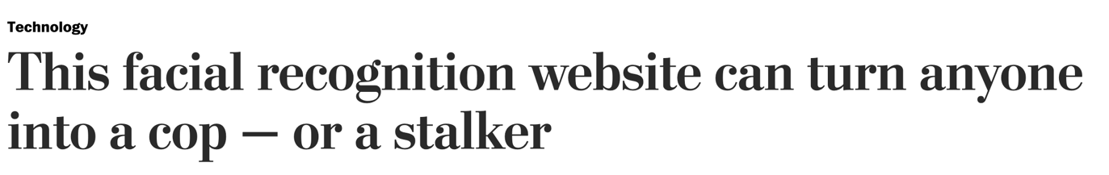
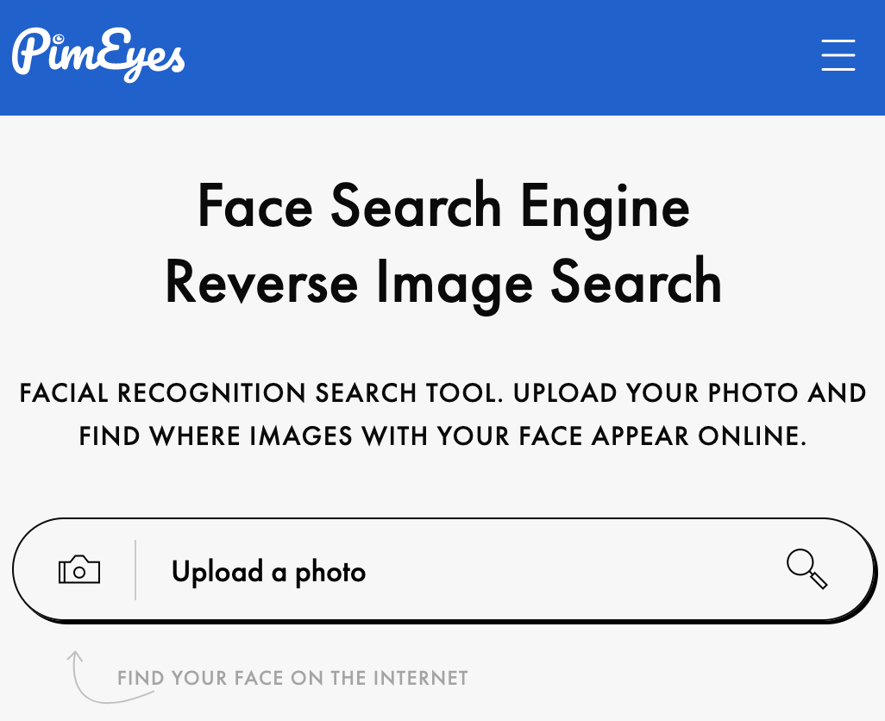
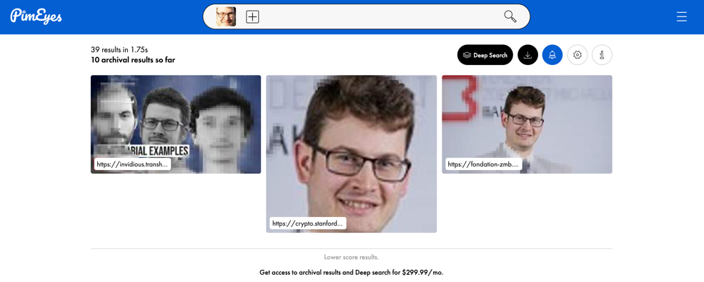
Big brother Everyone is watching you

Slide 10
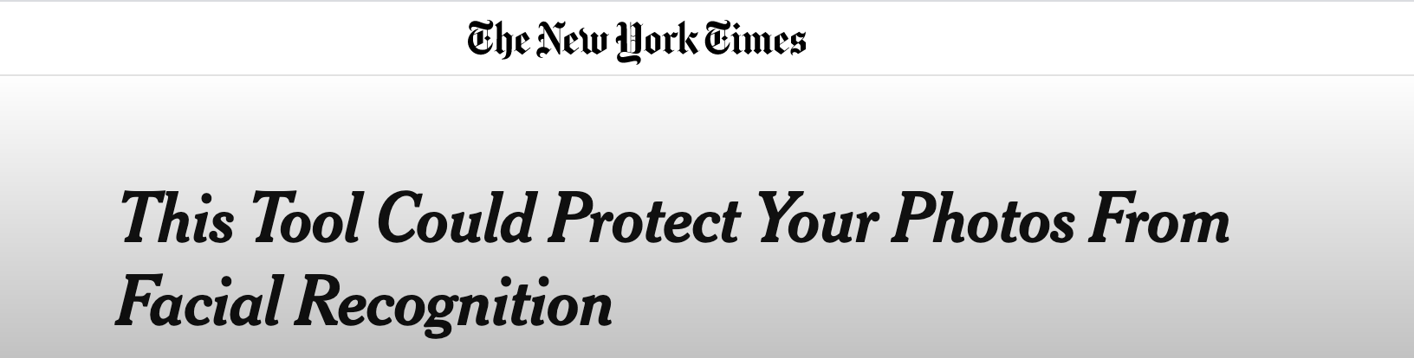
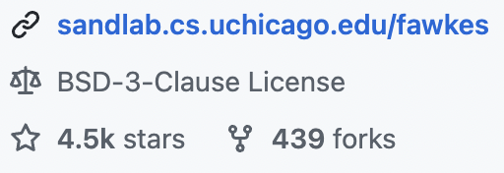
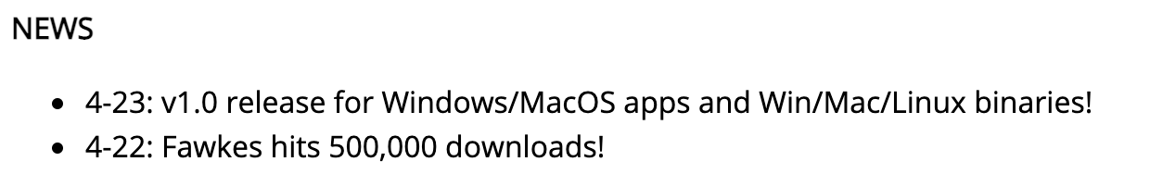
Can adversarial examples save us from this dystopia?
“Fawkes: Protecting Privacy against Unauthorized Deep Learning Models”, Shan et al., USENIX 2020
“LowKey: Leveraging Adversarial Attacks to Protect Social Media Users from Facial Recognition”, Cherepanova et al., ICLR 2021

Slide 11











Poisoning facial recognition with adversarial examples
Users perturb the pictures they post online
Online pictures are scraped to build a model
Unperturbed test pictures aren’t recognized
???
Unperturbed picture taken by the police, or a stalker, etc.

Slide 12
Misconception #1:
∀ models ∃ attack ≠ ∃ attack ∀ models
this is empirically true (so far)
credit: Nicholas Carlini

Slide 13
Misconception #2:
The attacker can adapt to any defense

Slide 14

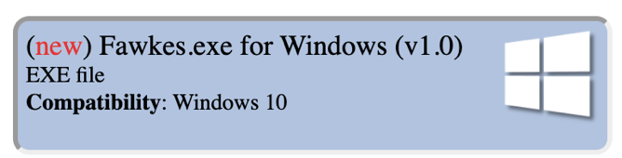
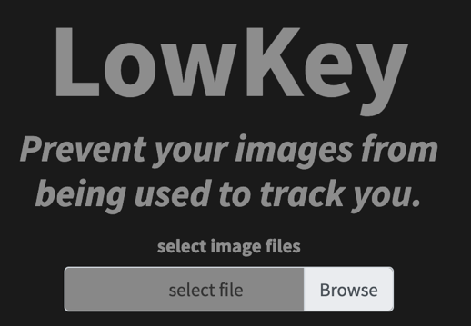

The problem (1): adaptive defenses
Adversarial training
“Data Poisoning Won’t Save You From Facial Recognition”, ICLR 2022

Slide 15


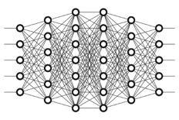
The problem (2): retroactive defenses
wait one year
Facial recognition provider scrapes pictures produced with attacks that target today’s models
Facial recognition provider trains new better model on poisoned data collected in the past
“Data Poisoning Won’t Save You From Facial Recognition”, ICLR 2022

Slide 16
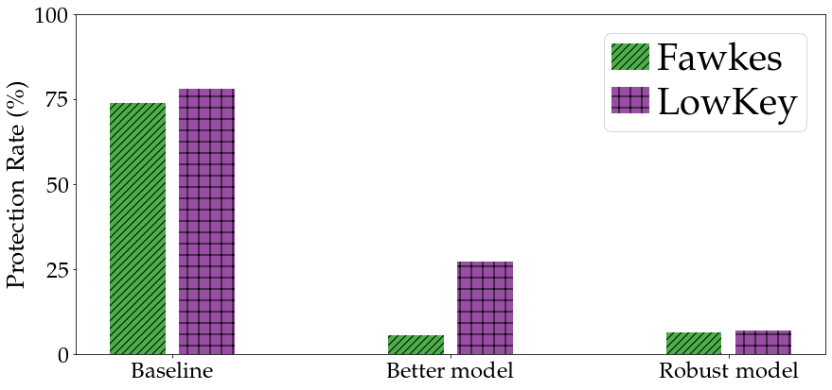
Adversarial examples won’t save us
“Data Poisoning Won’t Save You From Facial Recognition”, ICLR 2022

Slide 17
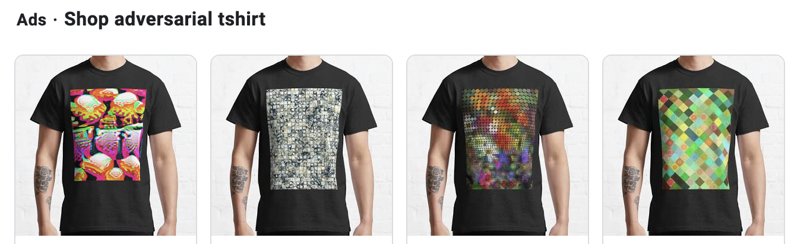
Are evasion attacks any better?
(+) Here, the attacker can adapt to the facial recognition system
(+) This works against YOLO* !
(-) What guarantee is there that this works against any real system?
(-) Are we giving people a false sense of security?

Slide 18
Claim: adversarial examples don’t work for
protecting against invasive models
protecting against privacy attacks
attacking anything “real” (for now)

Slide 19
Claim: adversarial examples don’t work for
protecting against invasive models
protecting against privacy attacks
attacking anything “real” (for now)

Slide 20

A simple privacy attack: membership inference
Was
in the training set?

Slide 21
Membership leakage from model confidence
distinguisher
if the example was not a member, the model wouldn’t be so confident
Member
Non-member
“Membership Inference Attacks against Machine Learning Models”, Shokri et al., IEEE S&P 2017

Slide 22

Defense idea: adversarial examples for distinguisher
distinguisher
Member
Non-member
top class is preserved to ensure defense does not lower utility
“MemGuard: Defending against Black-Box Membership Inference Attacks via Adversarial Examples”, Jia et al., CCS 2019

Slide 23
Misconception #1:
∀ models ∃ attack ≠ ∃ attack ∀ models

Slide 24
Misconception #2:
The attacker can adapt to any defense

Slide 25
Adaptive “defense”: ignore the noise
label-only
distinguisher
Member
top class is preserved to ensure defense does not lower utility
Non-member
“Label-Only Membership Inference Attacks”, ICML 2021

Slide 26
What can we compute with label-only access?
Model confidence
Gradient norm

Slide 27
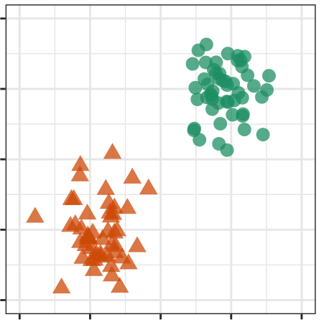
What can we compute with label-only access?
Model confidence
Gradient norm
Distance to decision boundary?
Same as finding a “minimal norm” adversarial example !

Slide 28
What can we compute with label-only access?
Model confidence
Gradient norm
Distance to decision boundary?
Same as finding a “minimal norm” adversarial example !
We can compute this with labels only! (decision-based attacks)
“Reliable Attacks Against Black-Box Machine Learning Models”, Brendel et al., ICLR 2018

Slide 29
Adversarial confidences don’t prevent inference
“Label-Only Membership Inference Attacks”, ICML 2021
“Membership Inference Attacks From First Principles”, preprint 2022

Slide 30
Claim: adversarial examples don’t work for
protecting against invasive models
protecting against privacy attacks
attacking anything “real” (for now)

Slide 31
Claim: adversarial examples don’t work for
protecting against invasive models
protecting against privacy attacks
attacking anything “real” (for now)

Slide 32
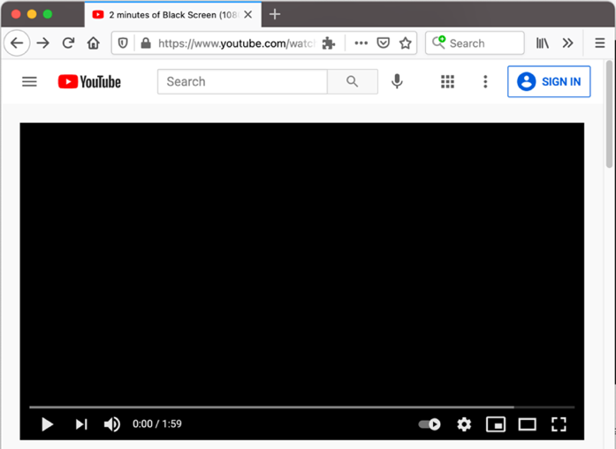

Evading research models vs. real systems
How do we go from this...
...to this?

Slide 33
Evading research models vs. real systems
Research: “imperceptible” perturbations
~95% white-box attacks/defenses
~5% black-box with query access
<1% black-box without query-access
Real systems: >99% black-box without query-access
attacks need not be imperceptible

Slide 34
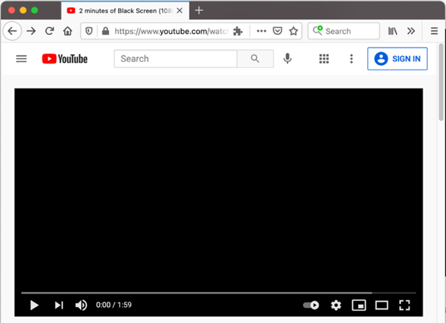

Real systems are black-box
Challenge: attack something like this
Not just an engineering exercise!
  you don’t get direct query access...
  you get banned after a few bad queries...
  you likely can’t build a good surrogate model...

Slide 35
Claim: adversarial examples don’t work for
protecting against invasive models
protecting against privacy attacks
attacking anything “real” (for now)

Slide 36
Claim: adversarial examples don’t work for
protecting against invasive models
protecting against privacy attacks
attacking anything “real” (for now)

Slide 37
Conclusion
Threat models matter! (who gets to go second?)
Be careful what promises you make to users
Can we use adversarial examples for something “real”?

